Slide 1
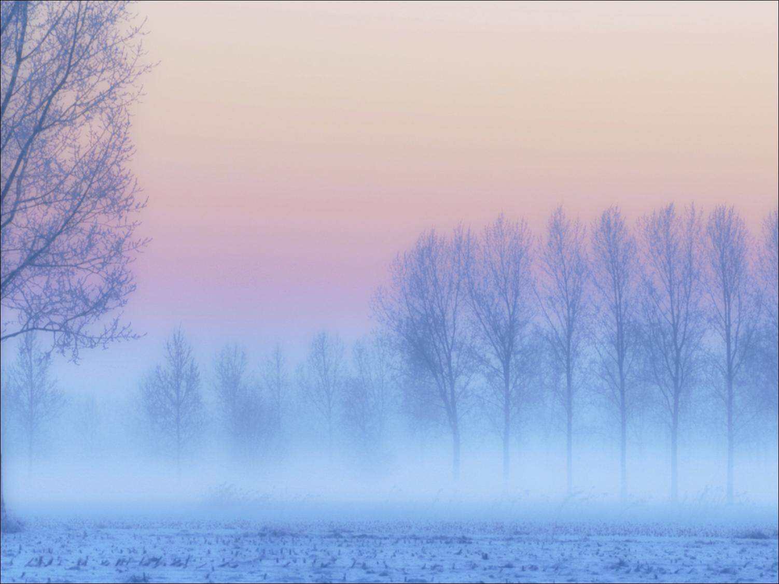
Открытый урок в 5 классе на тему:
«DRESS RIGHT»
Учитель английского языка
Пивкина Ирина Александровна

Slide 2

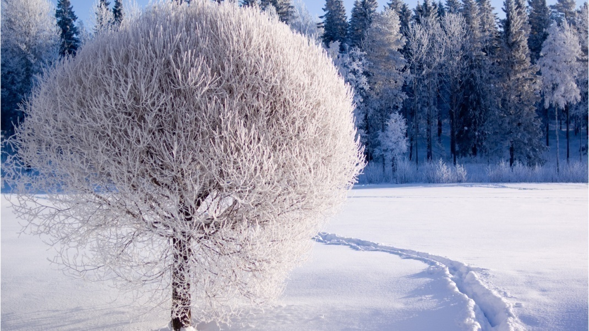

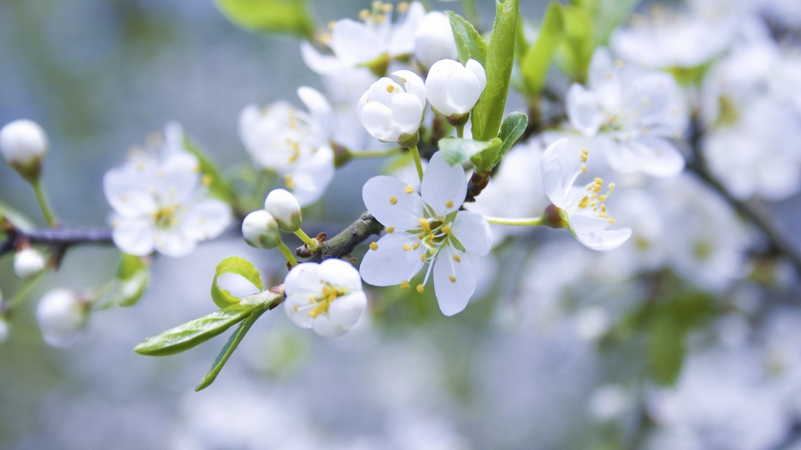
Seasons

Slide 3
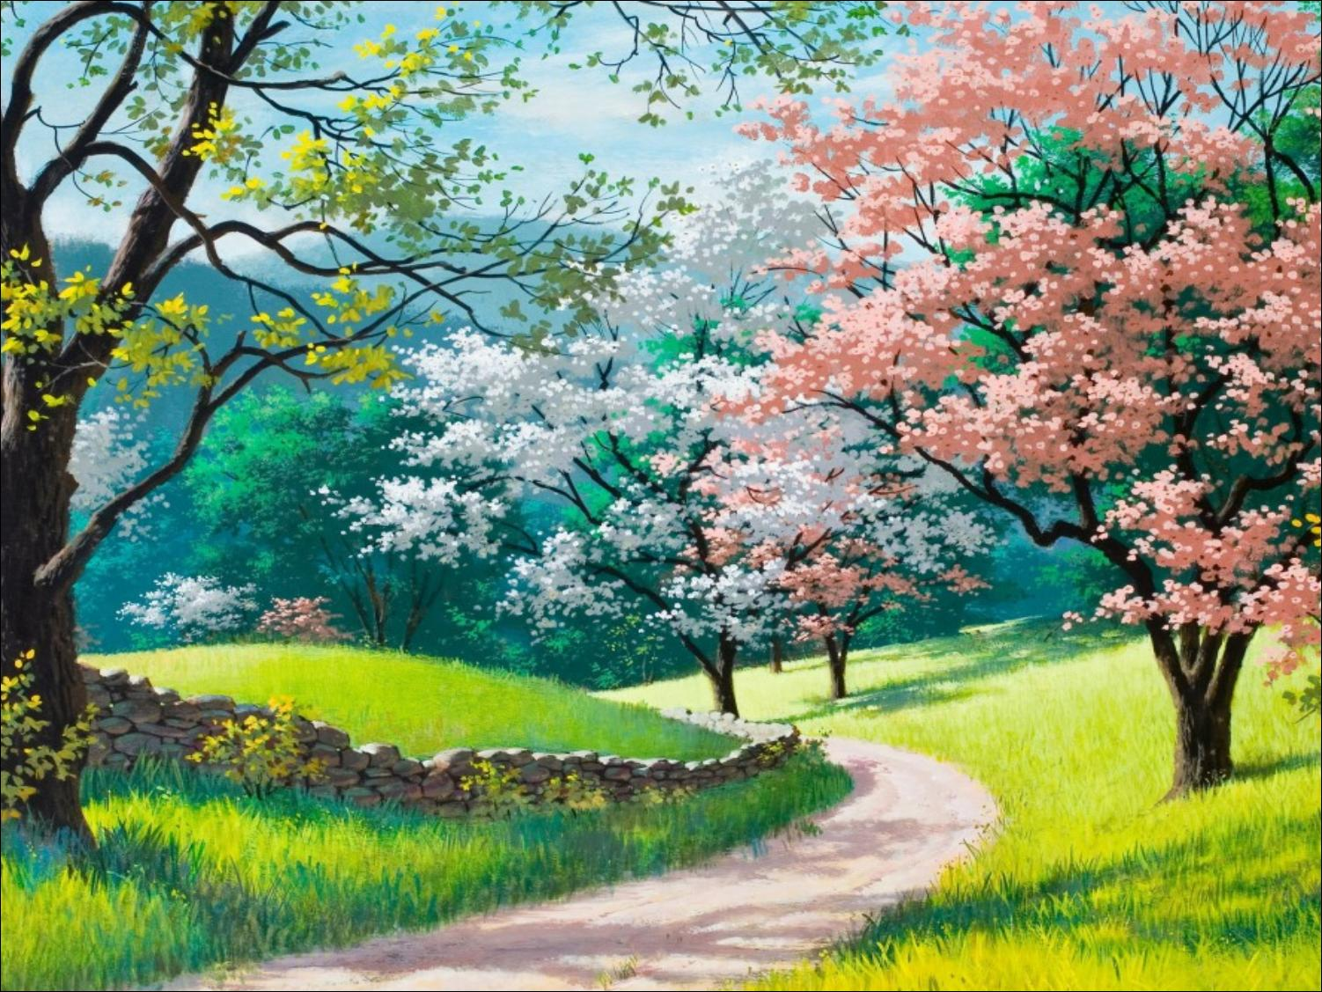
Spring
March
April
May

Slide 4

Summer
June
July
August

Slide 5
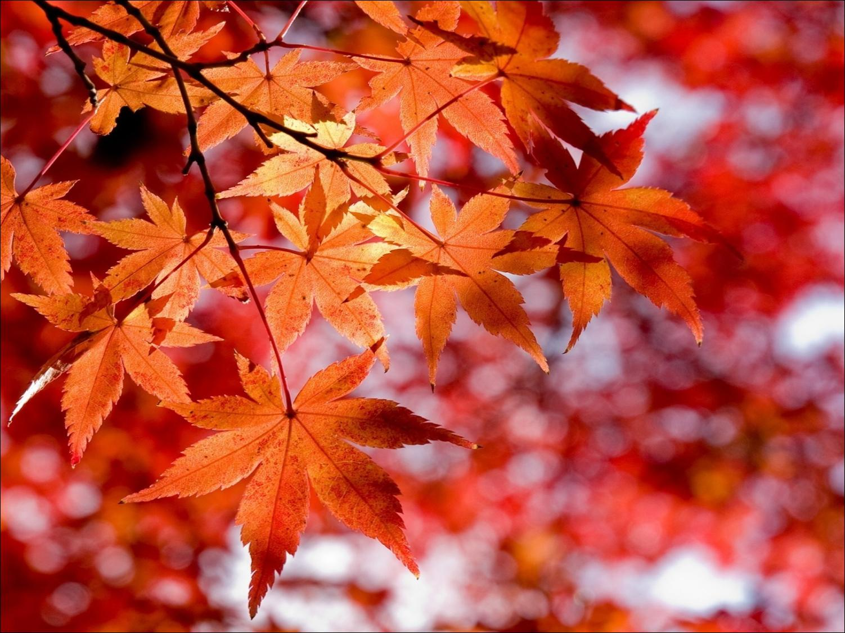
Autumn
September
October
November

Slide 6
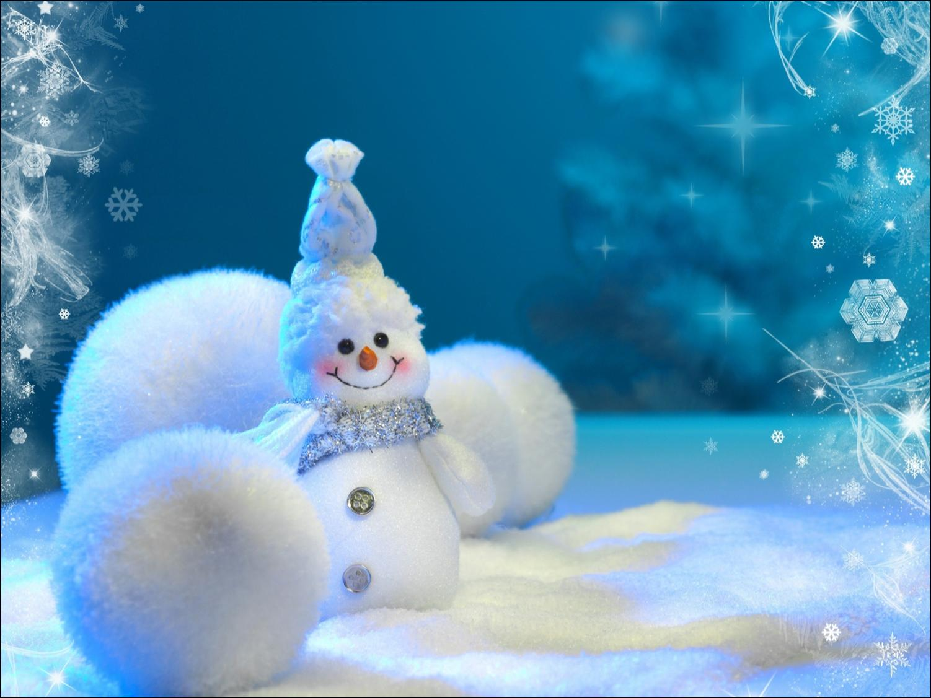
Winter
December
January
February

Slide 7
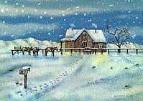


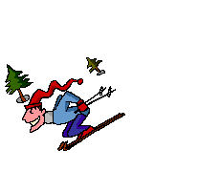

My favourite season is .
There is much in winter.
The weather is in winter.
I can and play in winter.

Slide 8
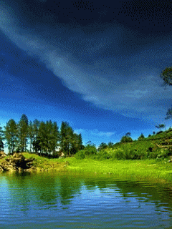

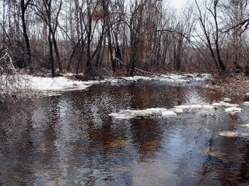


My favourite season is .
The weather is and warm.
It in spring.
I can in the street and play
in spring.

Slide 9
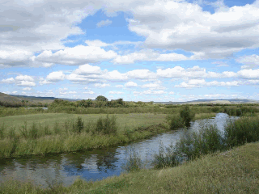




My favourite season is .
The weather is and hot.
It sometimes in summer.
I can in the river and in the sun.

Slide 10




My favourite season is .
The weather is often in autumn.
The trees change their colour from
green to .
I can and play in autumn.

Slide 11
There is no bad…
There are only bad …
clothes
weather

Slide 12
There is no bad weather
There are bad clothes

Slide 13
«DRESS
RIGHT»

Slide 14
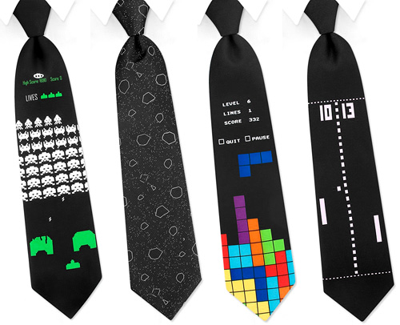

Slide 15
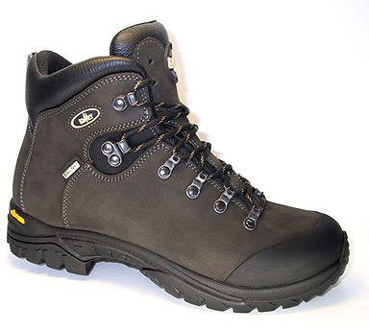

Slide 16
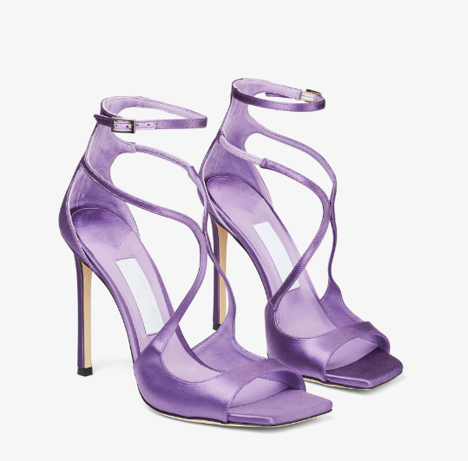

Slide 17
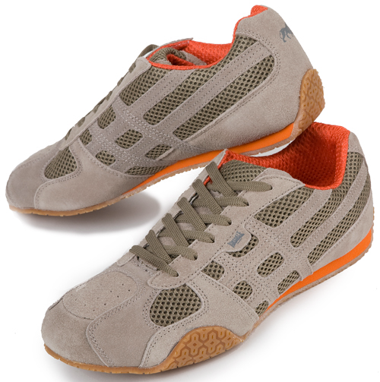

Slide 18
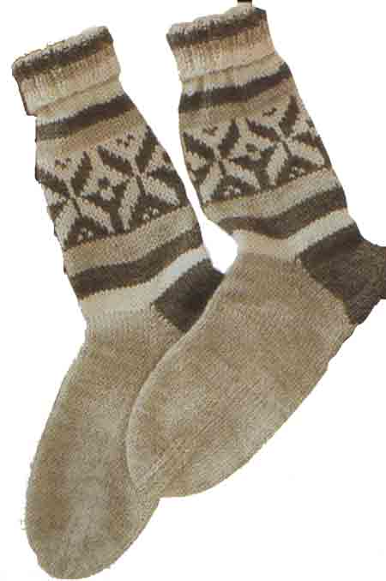

Slide 19
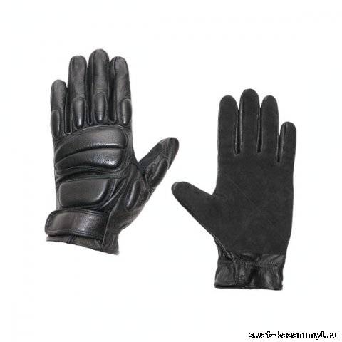

Slide 20


Slide 21
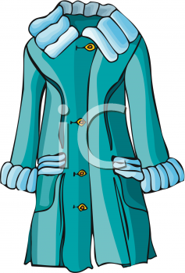

Slide 22
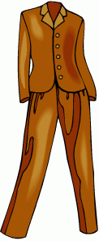

Slide 23


Slide 24
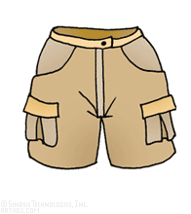

Slide 25
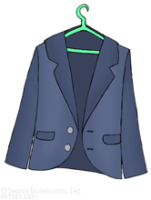

Slide 26
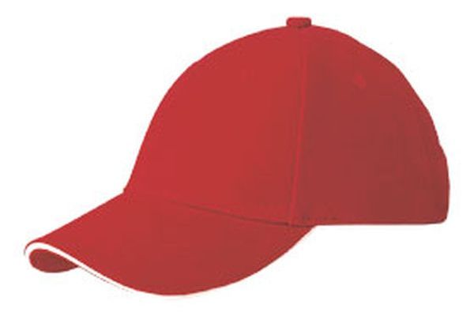

Slide 27
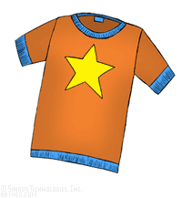

Slide 28
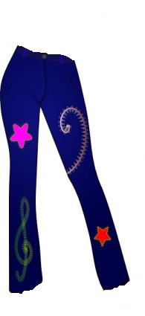

Slide 29
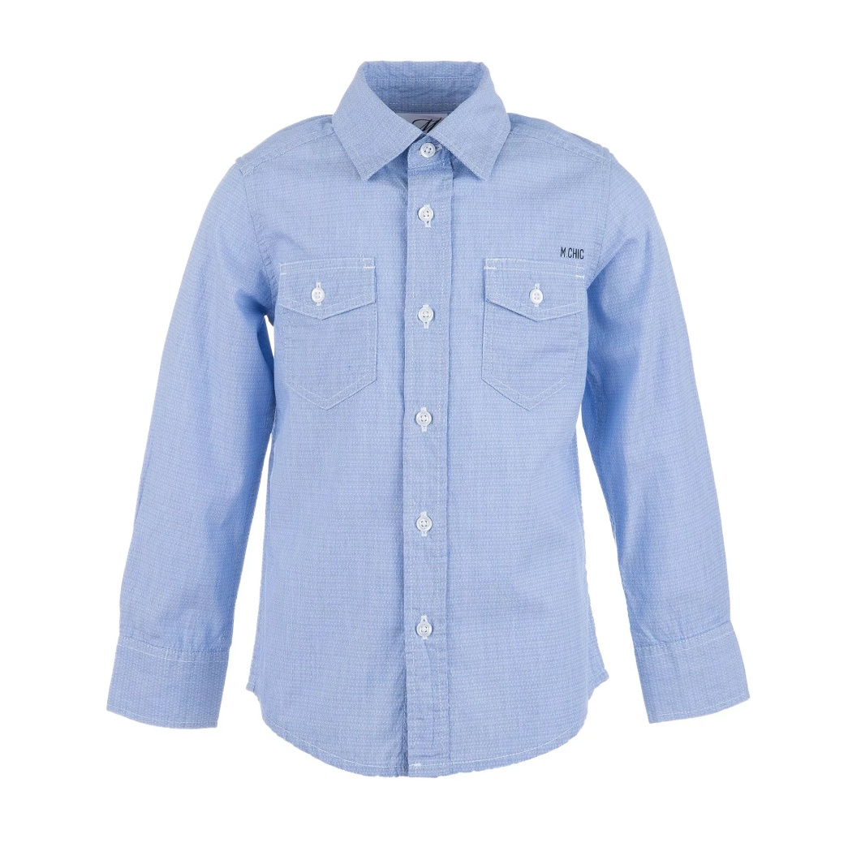

Slide 30
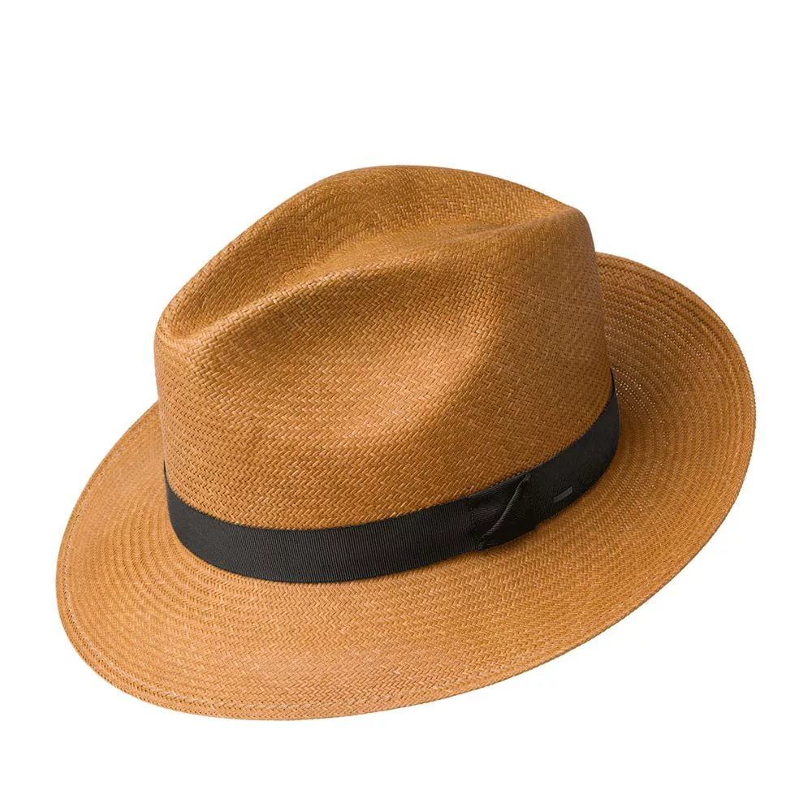

Slide 31
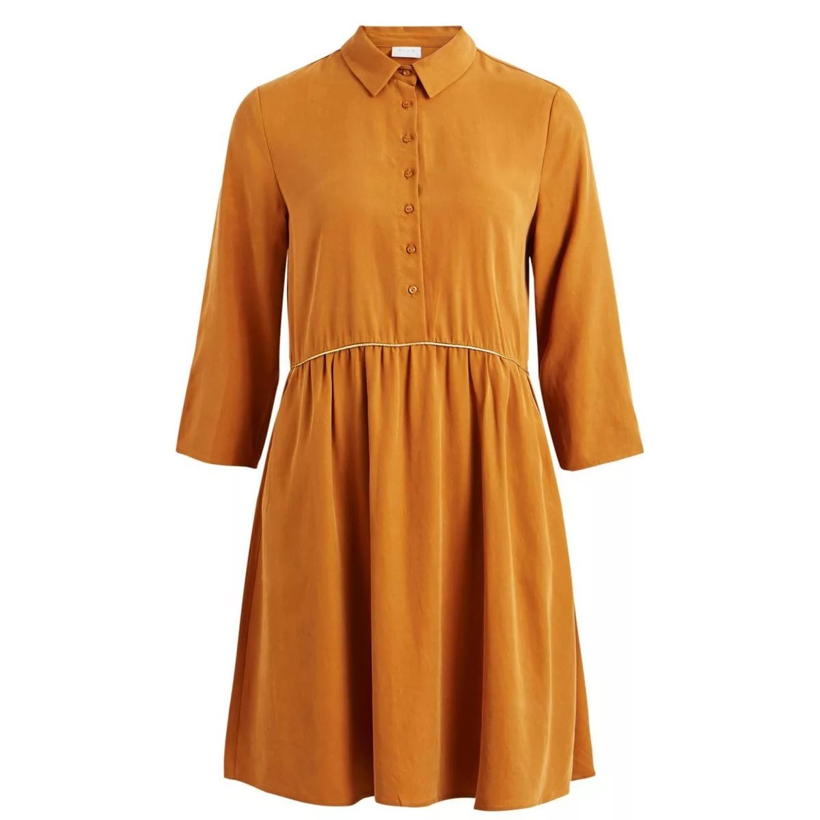

Slide 32
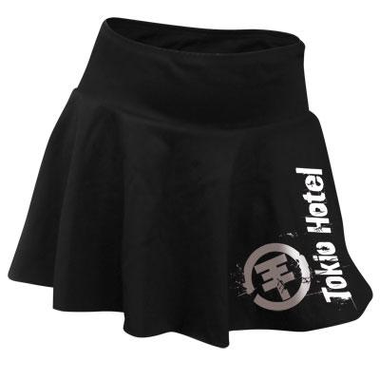

Slide 33
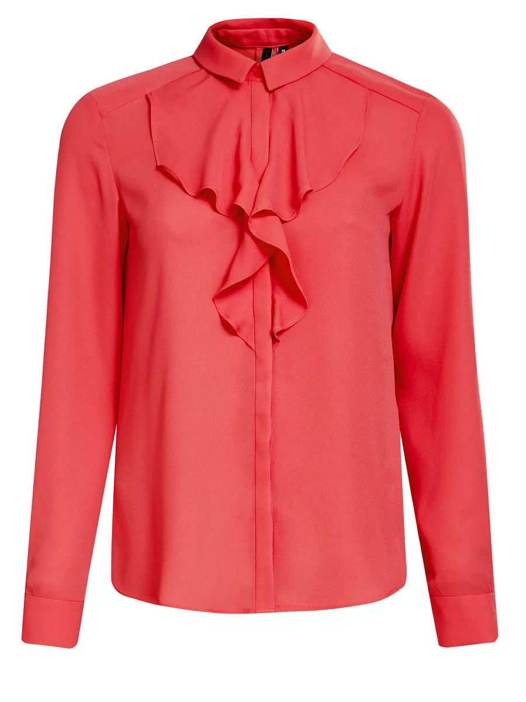

Slide 34
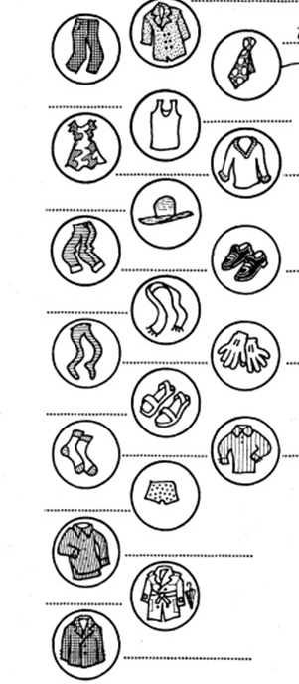
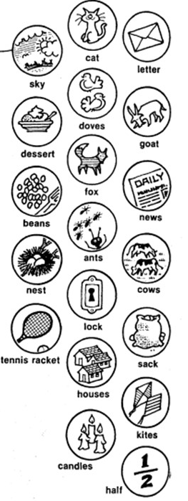

Slide 35
PRESENT SIMPLE TENSE
Утвердительная форма
V / V – s, - es
I ,we, you, they – read
He, she, it – reads
Отрицательная форма
Don’t / doesn’t + V
Вопросительная форма
Do / Does …V… ?

Slide 36
PRESENT CONTINUOUS TENSE
Утвердительная форма
Аm, is, are + V – ing
Отрицательная форма
аm, is, are + not + V – ing
Вопросительная форма
аm, is, are …V – ing ?

Slide 37
«CLOTHES
IN ALL
WEATHERS»

Slide 38

What was interesting?

Slide 39


What was difficult?
What was easy?

