Slide 1
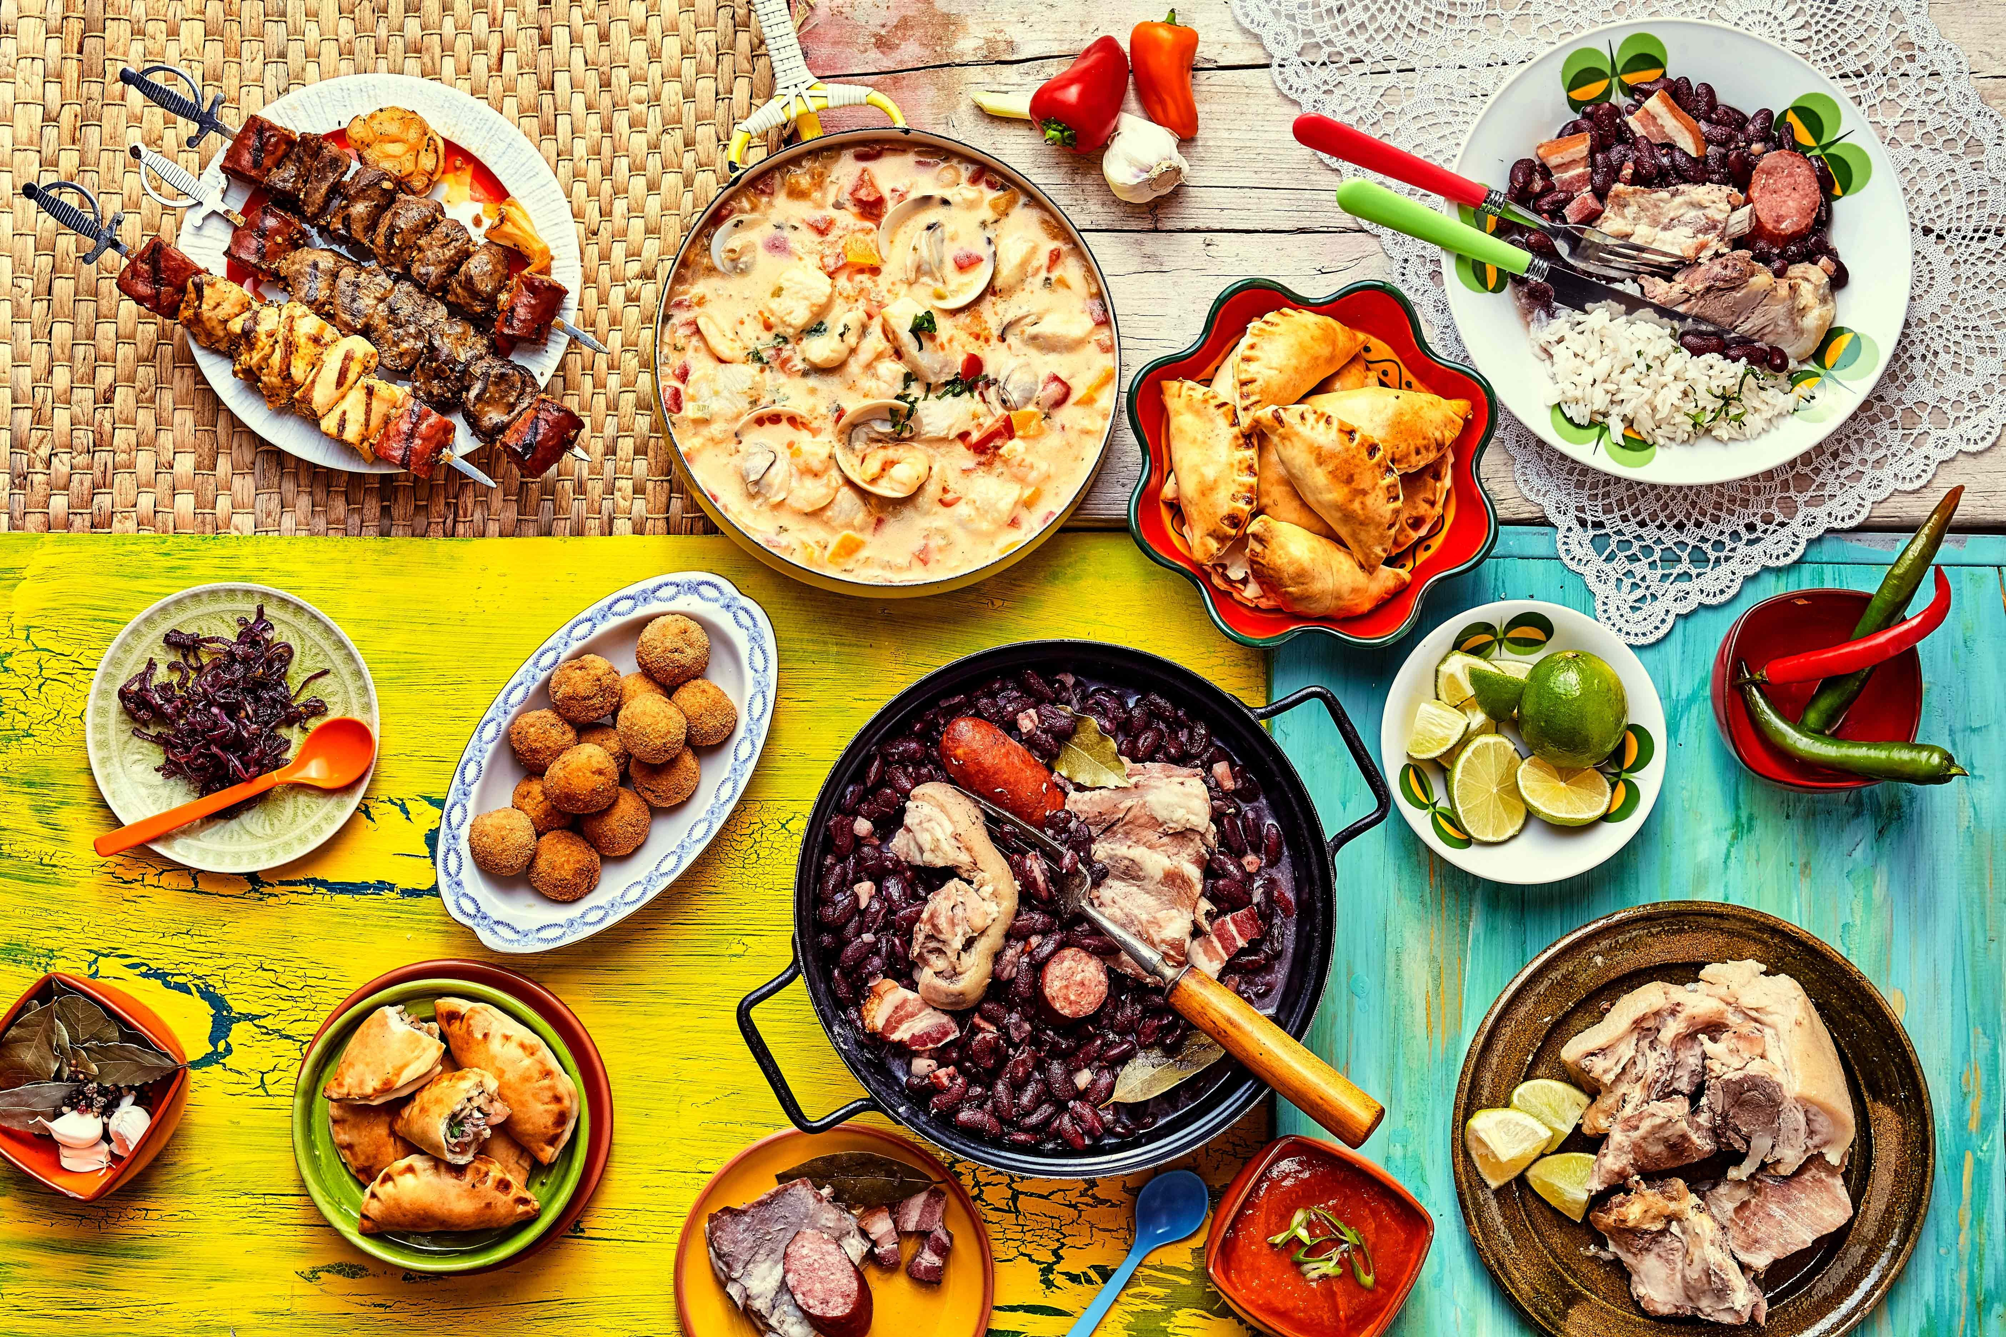
Each country has own traditions of cooking and national dishes

Slide 2
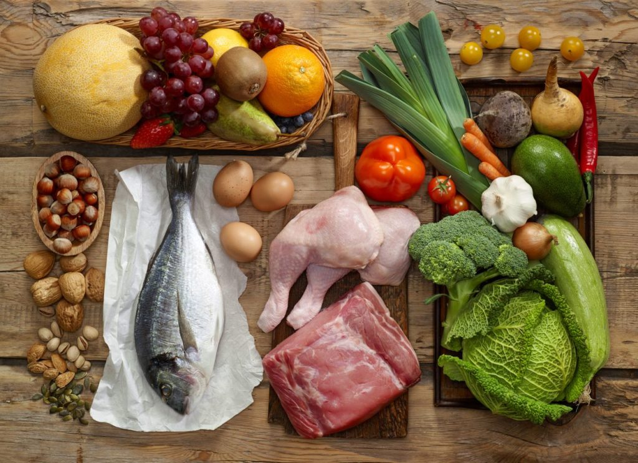
Bread and wheat products, vegetables, meat and fish.

Slide 3
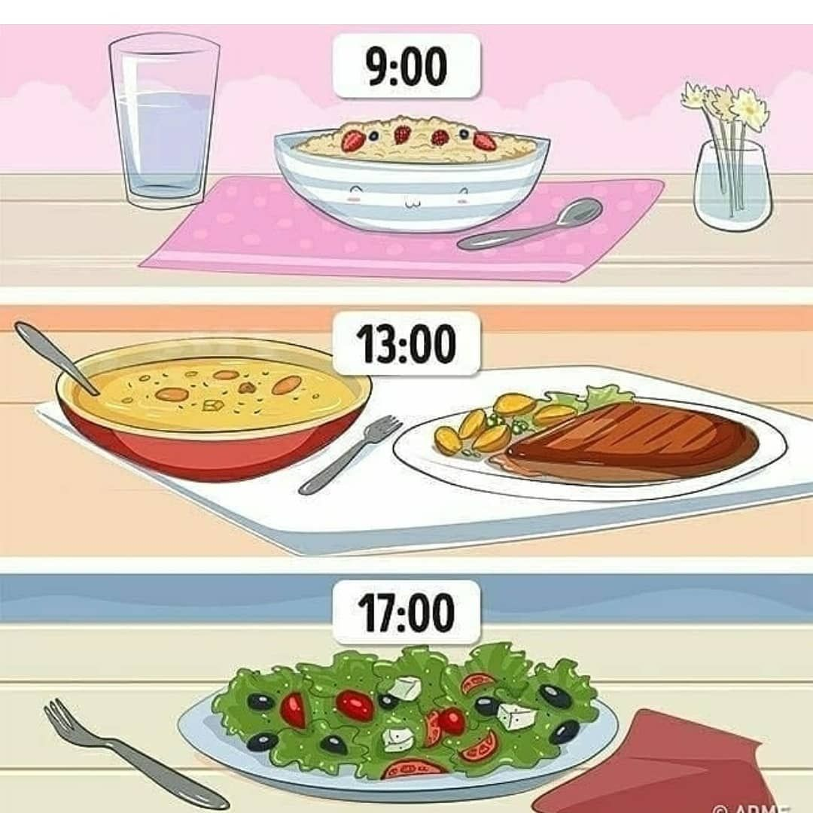
Russians usually have 3 meals a day: breakfast, dinner and supper

Slide 4
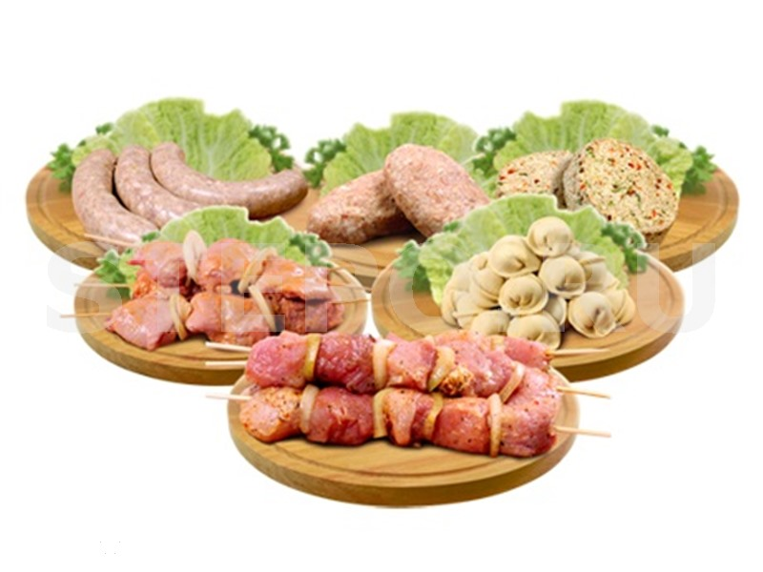
Dumplings, cutlet, barbecue

Slide 5
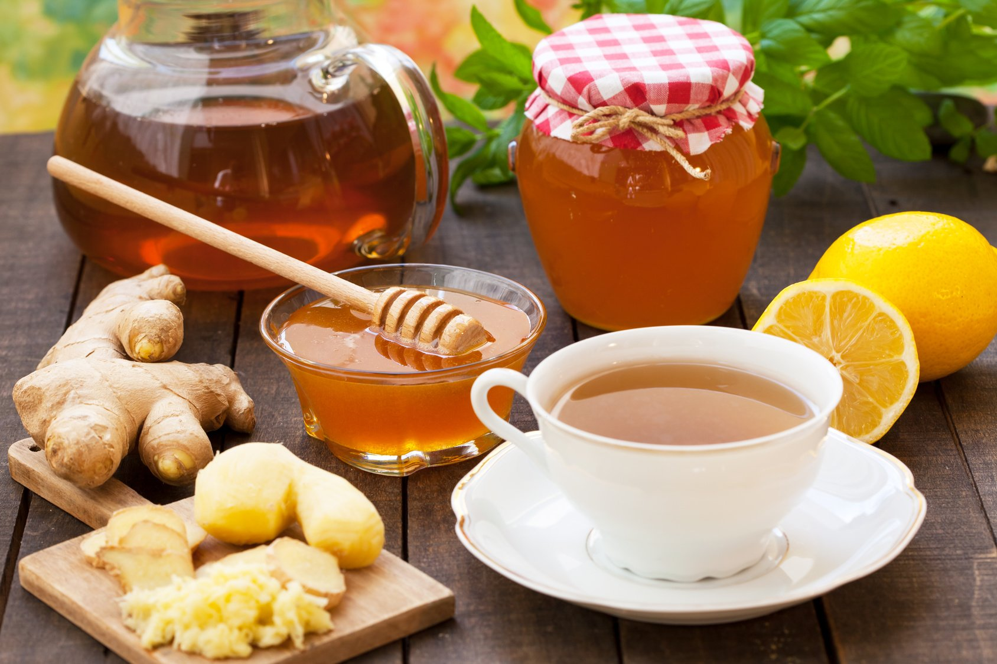
Russian people like to drink hot tea with jam or honey

Slide 6
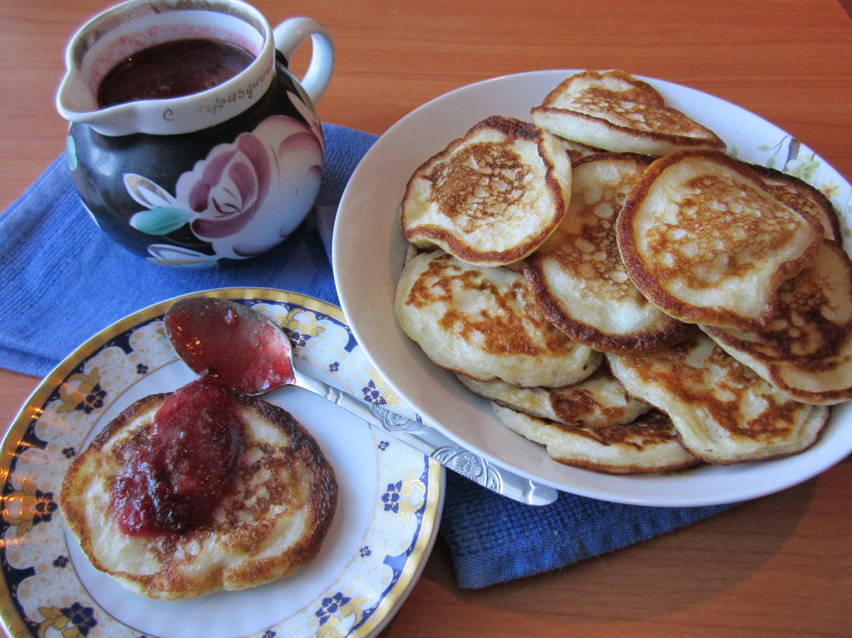
They cook pancakes or cheesecakes for the dessert

Slide 7
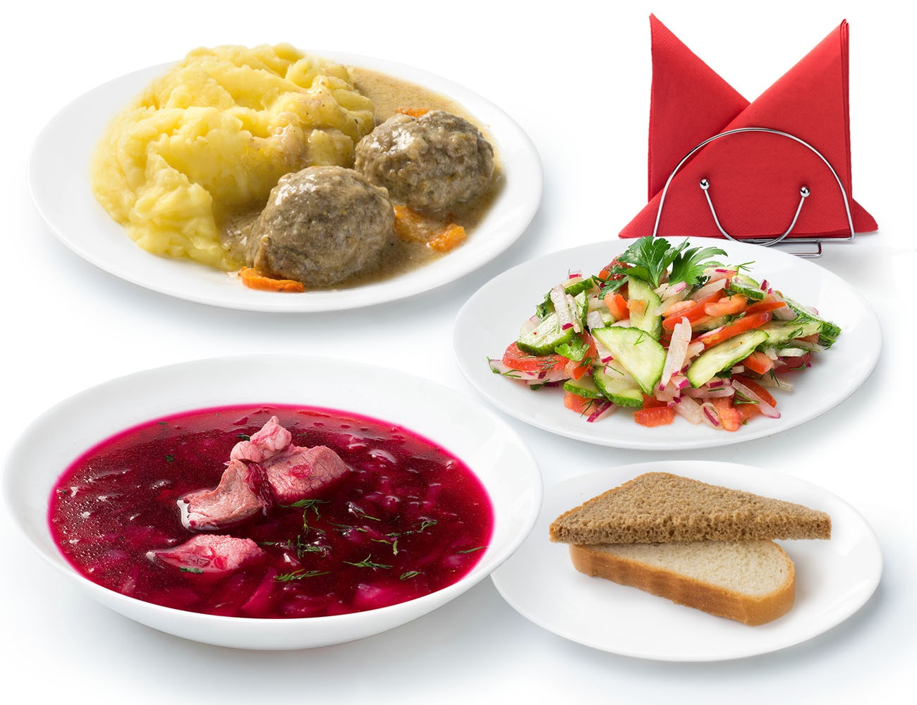
My favourite dishes are borscht and cutlet with mashed potatoes

Slide 8
Thank you for your attention!

