Slide 1



Slide 2



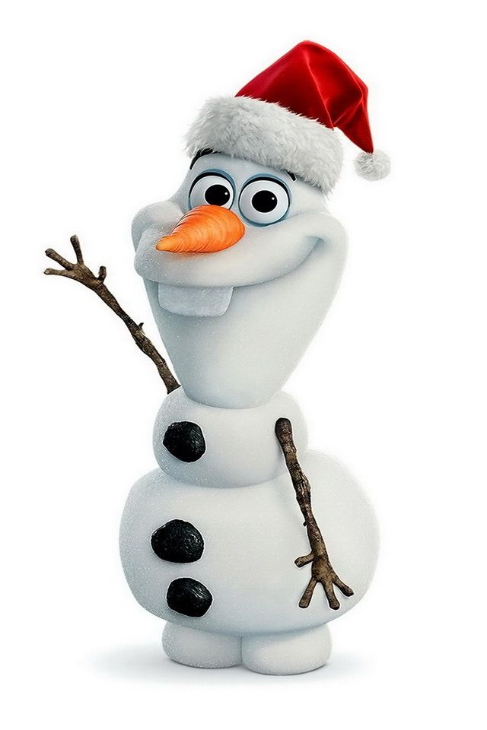
Name cartoon characters

Slide 3
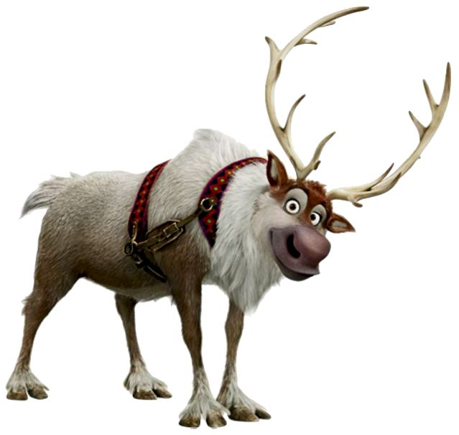
Name cartoon characters

Slide 4
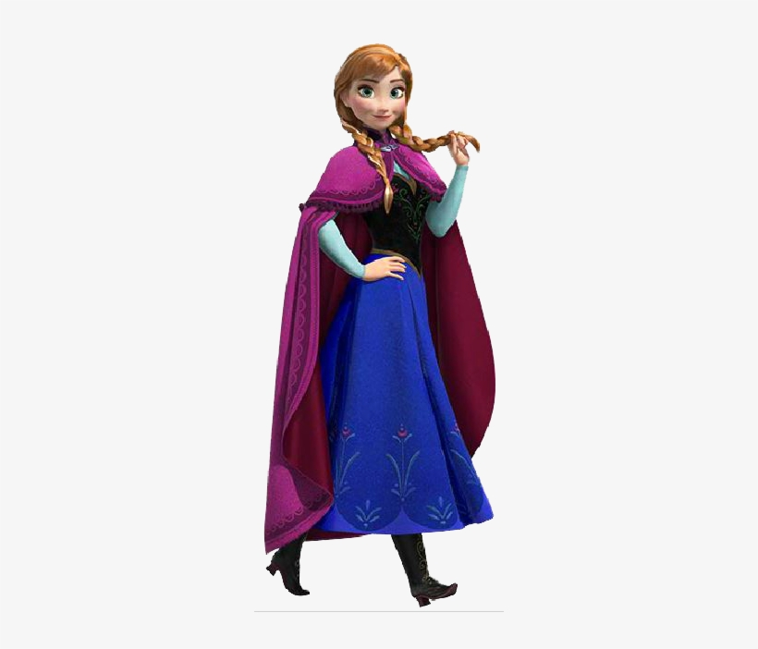
Name cartoon characters

Slide 5
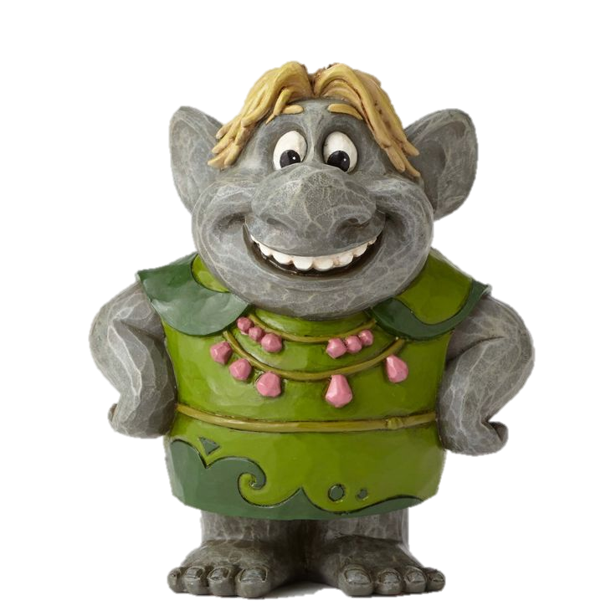
Name cartoon characters

Slide 6
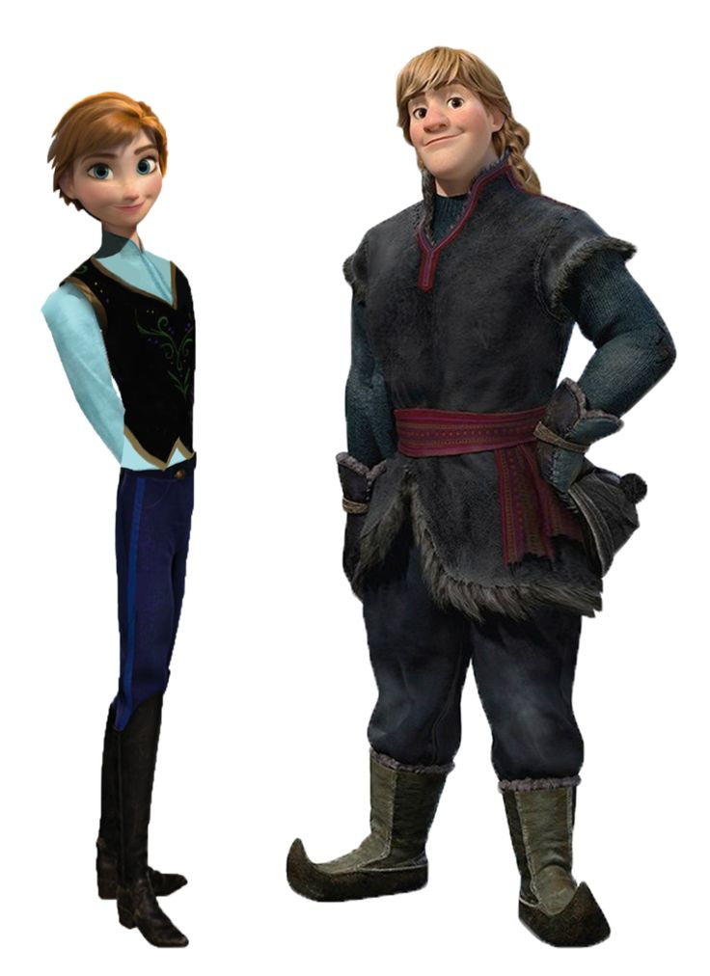
Name cartoon characters

