Slide 1
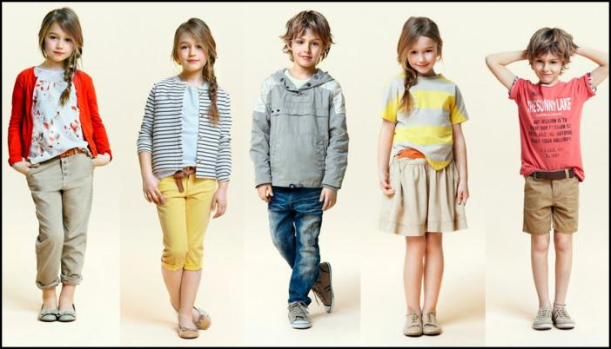
Dress right!
7

Slide 2
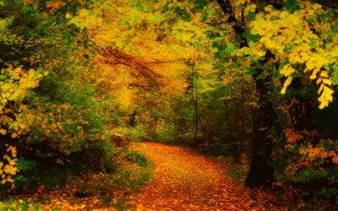
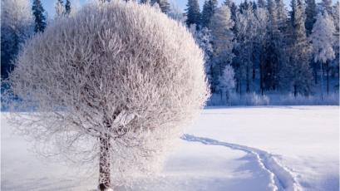

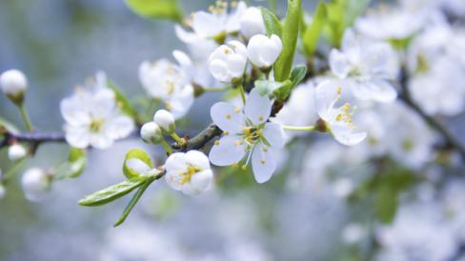
Seasons.

Slide 3
[ t ] – terrible, hot, melt, frost, hate, autumn;
[ d ] – dry, cold, cloud, cloudy;
[ s ] – snow, snowy, sunny, spring,
season, summer;
[ w ] – weather, wet, windy, warm,
winter.

Slide 4

Find the odd words :
January, February, December
June, July, August
September, October, November
April, March, May
winter, summer, autumn
Rain, snow, wind,
hot, nice, fine
March,
May,
April,
Winter,
November,
nice
Grey,

Slide 5
Make up sentences using these words.
We can | make a snowman ski skate ride a bike play football play hockey swim in the river lie in the sun fish | in | winter spring summer autumn

Slide 6
True or false?
In winter there is a lot of snow.
Summer comes after winter.
Autumn is the warmest season of the year.
Summer is warmer than spring.
There are five seasons in a year.
There is a lot of fruit in autumn.
Winter is the coldest season of the year.
Summer holidays are the longest.
It often snows in winter.
There are twelve months in a year.
1 4 6 7 8 9 10

Slide 7
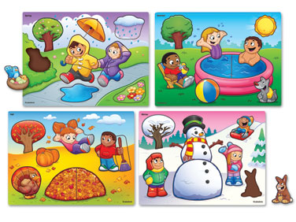
Complete the sentences:
winter
Snowflakes fall in .
Flowers grow in .
Leaves turn brown in .
New leaves grow on trees in .
The days are long in .
Leaves fall in .
Flowers don’t grow in .
The birds make their nests in .
The sun shines brightly in .
The days are short and the nights are long in
It often rains in .
It often snows in .
summer
autumn
spring
summer
autumn
winter
spring
summer
winter.
autumn
winter

Slide 8
English proverbs about seasons :
April weather, Rain and sunshine both together. | То дождь, то солнце.
Every thing is good in its season. | Всему своё время.
April showers bring May flowers. | В апреле дожди – в мае цветы.
A tree is known by its fruit. | Яблоко от яблони недалеко падает.

Slide 9
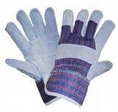
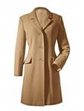
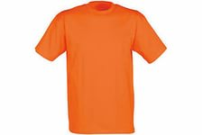
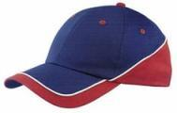
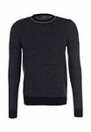
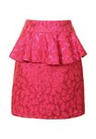
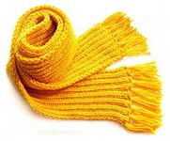
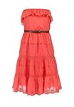
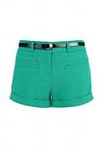
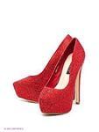
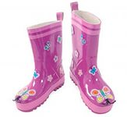
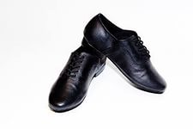

Slide 10
LET’S TALK ABOUT THE RULES
PRESENT SIMPLE
We use Present Simple to describe the action which takes place regularly, every day.
For example:
She always wears boots in winter.
PRESENT CONTINUOUS
We use Present Continuous to describe the actions which takes place right now.
For example:
She is wearing boots now.

Slide 11
Try to correct mistakes.
PRESENT SIMPLE | PRESENT CONTINUOUS
to be + V ing | every day
now | at the moment
often | do - does
listening | writes
usually | always
He She Vs it | usually

Slide 12
What clothes is suitable when it is cold/hot/rainy/sunny?

Slide 13
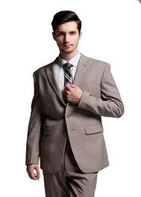
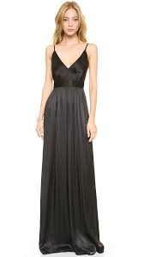
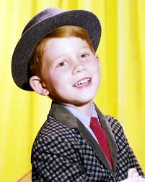
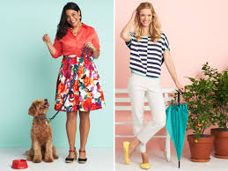
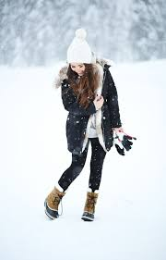
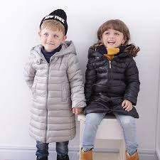
What are they wearing now?

Slide 14
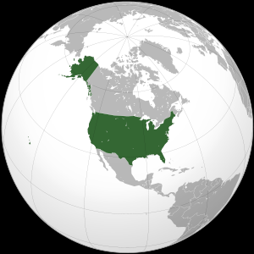
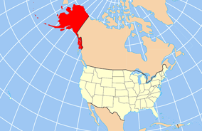
What country is it?

Slide 15
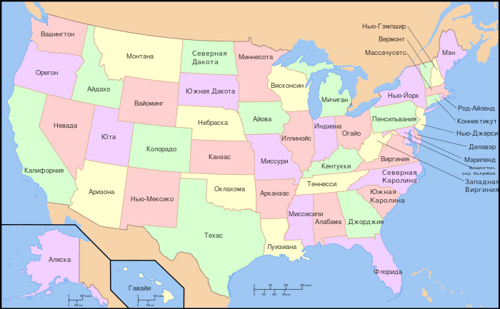
How many states are there in the USA?

Slide 16
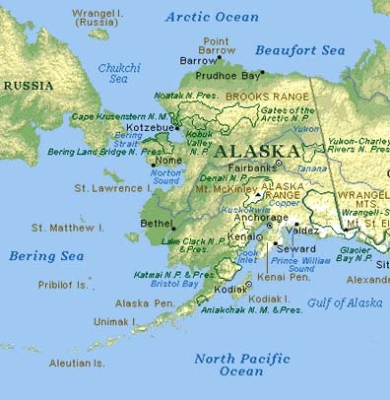

What is the largest state of the USA?

Slide 17
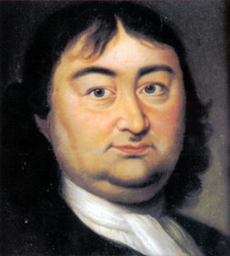
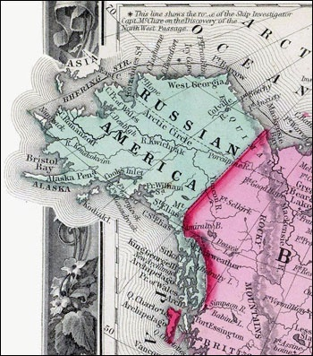
Who discovered Alaska?

Slide 18
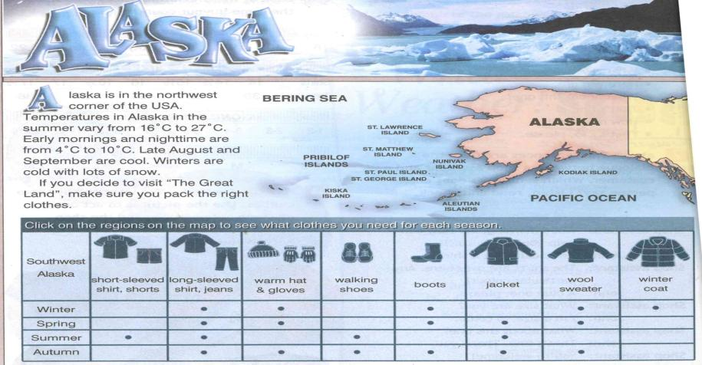
Let’s join the Internet-club!
”
www.spotlightinrussia.ru

Slide 19
Russia
1. Russia is in East Europe … 2. In winter, it’s cool along the Black Sea coast … 3. In summer, it’s warm … 4. If you decide to visit Russia, … 5. In winter, take a heavy wool sweater, 6. In summer, take a long-sleeved shirt, … | A. a winter coat, boots and gloves and a scarf. B. and it is freezing in Siberia. C. and Northern Asia. D. make sure you pack the right clothes. E. in the steppes and cool along the Arctic coast. F. walking shoes and a jacket.

Slide 20

Проект на стр.9 (раздел о России)
р/т упр.3 стр.57

