Slide 1
своя игра

Slide 2
School things | 100 | 200 | 300 | 400
Jobs | 100 | 200 | 300 | 400
Place of Interest | 100 | 200 | 300 | 400
Holidays | 100 | 200 | 300 | 400

Slide 3
What school things do you have?

Slide 4
Answer: I have a pencil. I have a school bag. I have a pencil case.
back

Slide 5
Match the words
1) Physical a) case
2) Information b) Technology
3) pencil c) Education

Slide 6
Answer:
Physical Education
Information Technology
Pencil case
back

Slide 7
Where do you store your pens and pencil?

Slide 8
Answer: pencil case
back

Slide 9
Name the subject:
The study of the Earth and its countries, mountains, rivers, weather.

Slide 10
Answer: Geography
back

Slide 11
Someone who plays piano is a…..
a. pianist
b. singer
c. painter

Slide 12
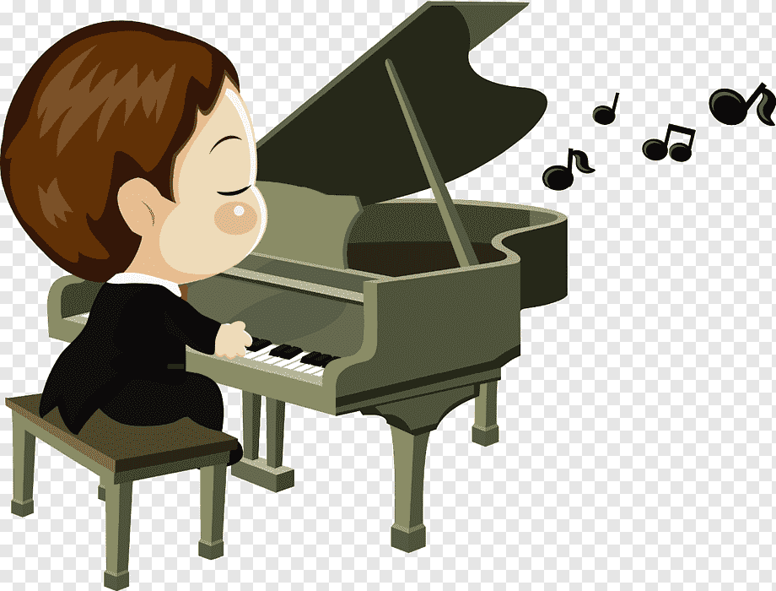
Answer: pianist
back

Slide 13
Read the transcription
[ mi’kænik]
back

Slide 14
Who is this person?
She work in the hospital. She helps sick people.
She wears a uniform.

Slide 15
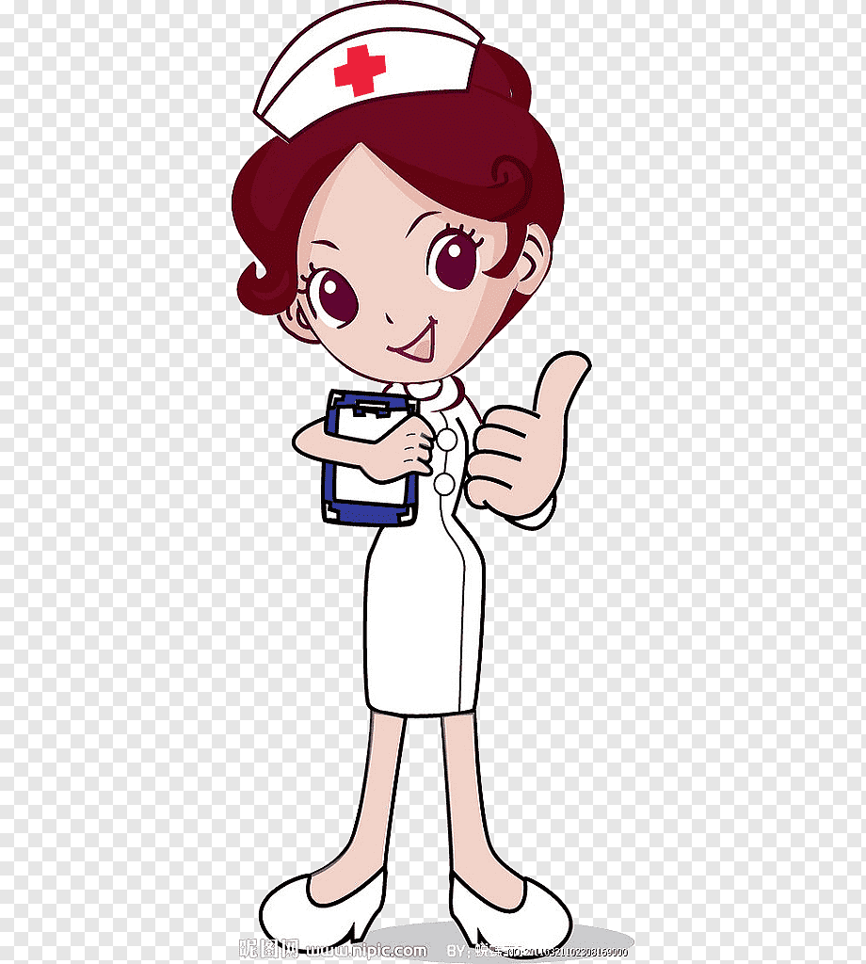
Answer: Nurse
back

Slide 16
Кот в мешке

Slide 17
What animals can we watch in the Zoo? Name at least 5 animals.
back

Slide 18
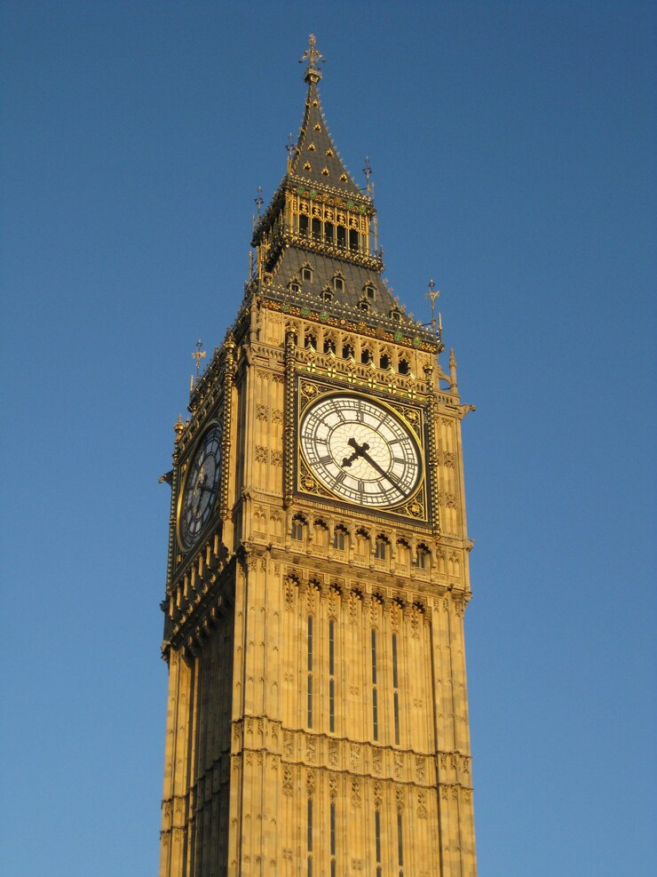
What is it?

Slide 19
Answer: Big Ben
back

Slide 20
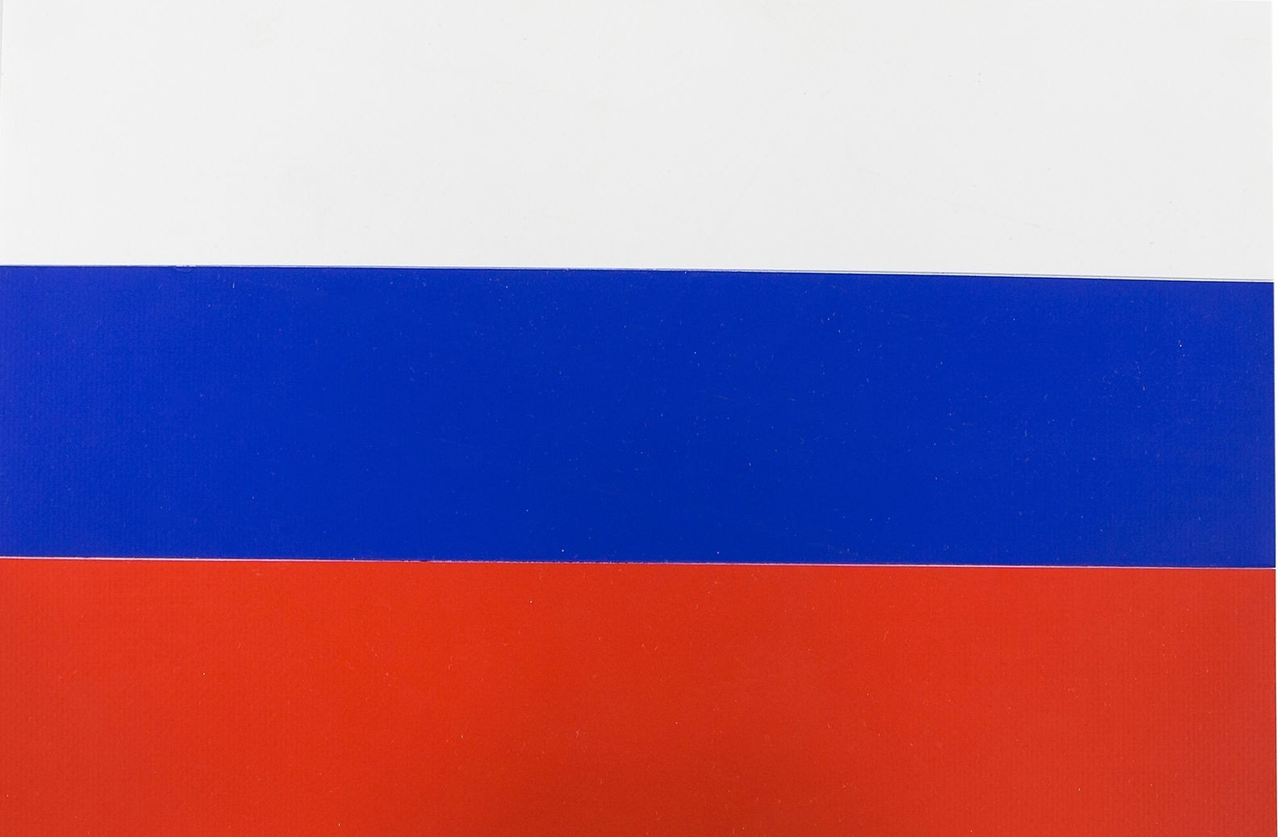
Witch of these flag is a British flag.
1
2
3
back

Slide 21
London is the capital of…
a. Scotland
b. Great Britain
c. America

Slide 22
Answer: Great Britain
back

Slide 23
The queen lives in…
A. Buckingham Palace
b. The Tower of London
c. Big Ben

Slide 24
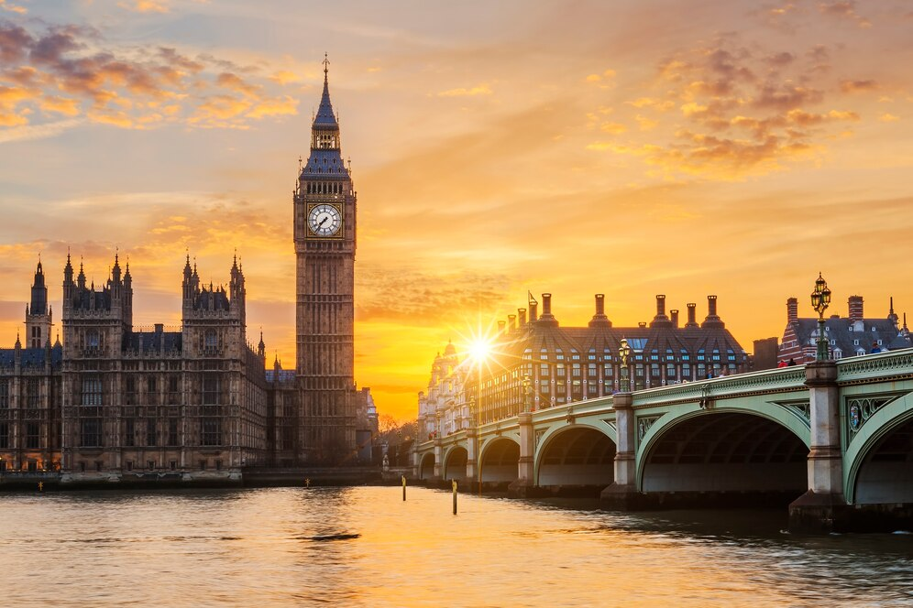
Answer: Buckingham Palace
back

Slide 25
What season in Australia when they celebrate Christmas?

Slide 26
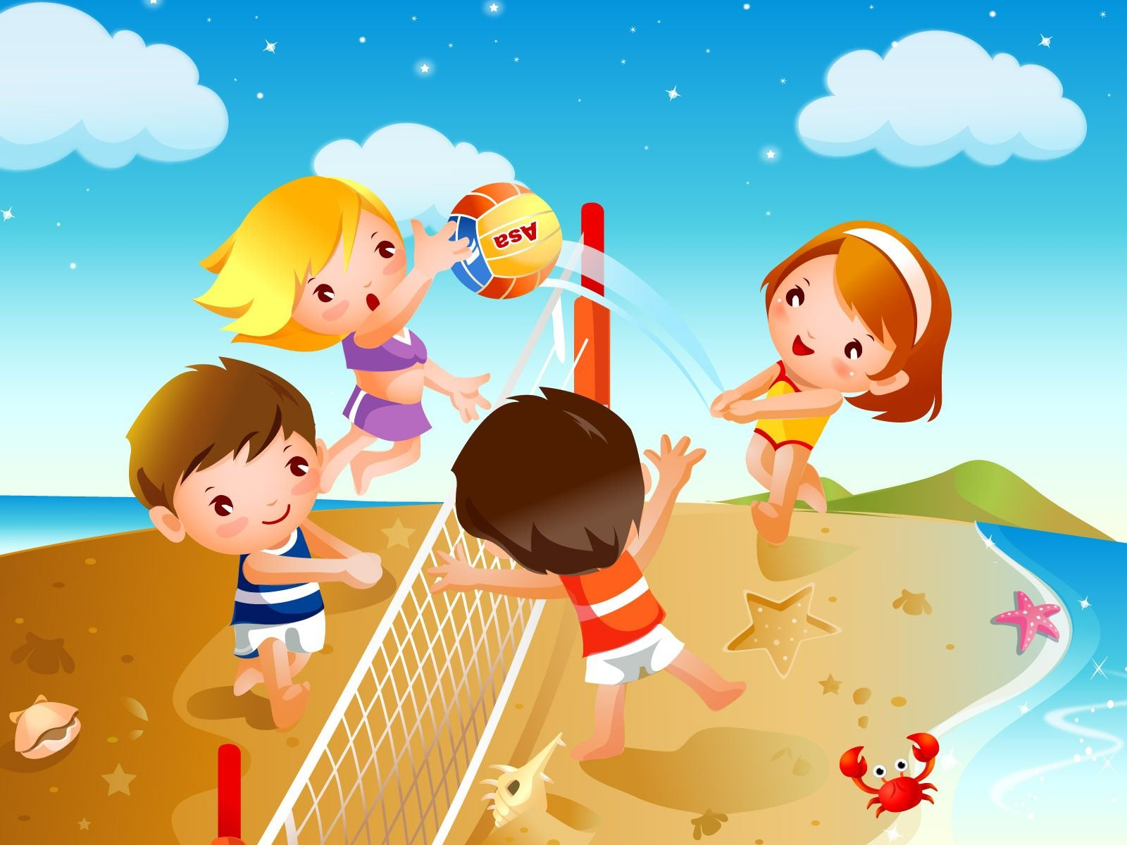
Answer: summer
back

Slide 27
When does New Year begin?

Slide 28
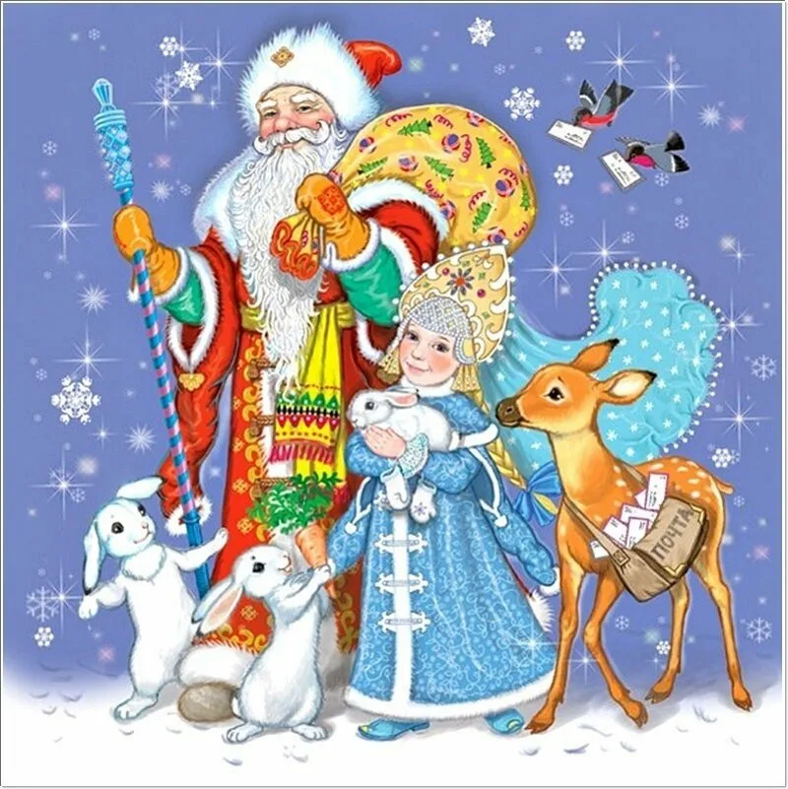
Answer: 1st January
back

Slide 29
What is the name of Russian Santa Claus?

Slide 30
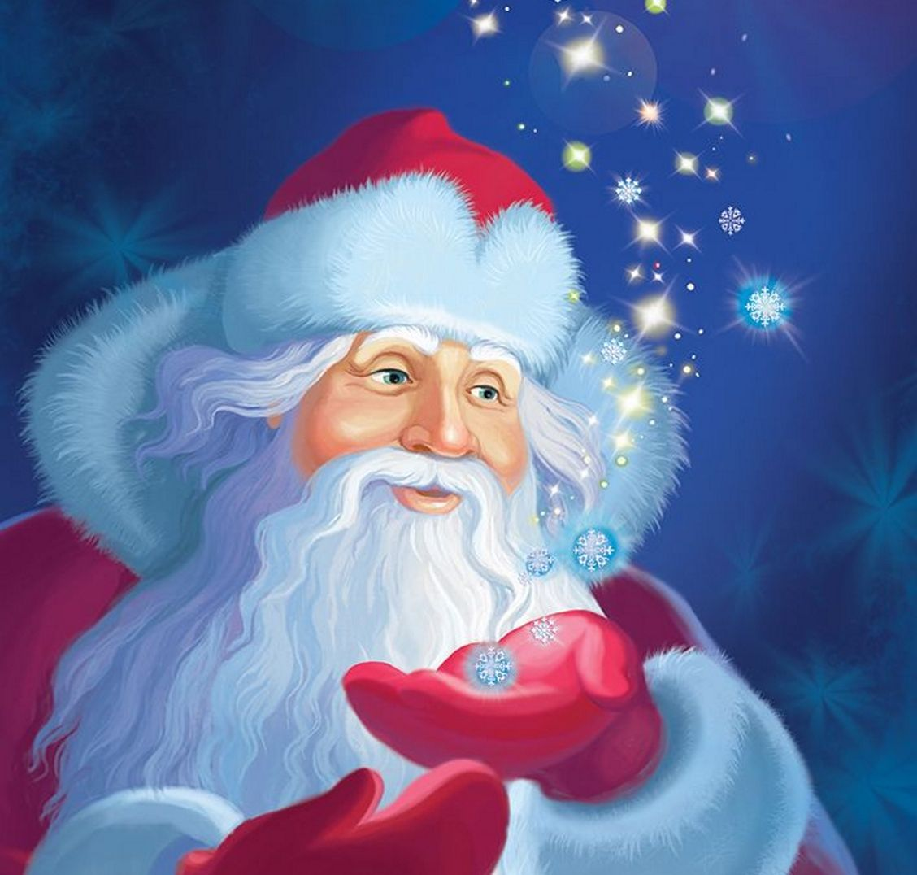
Answer: Father Frost
back

Slide 31
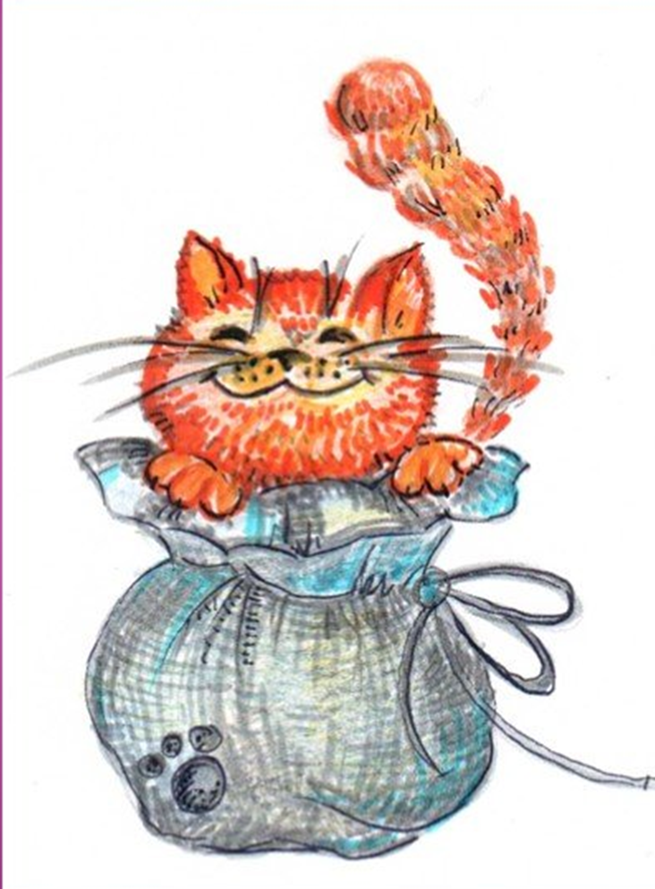
Кот в мешке

Slide 32
What season is it now?

Slide 33
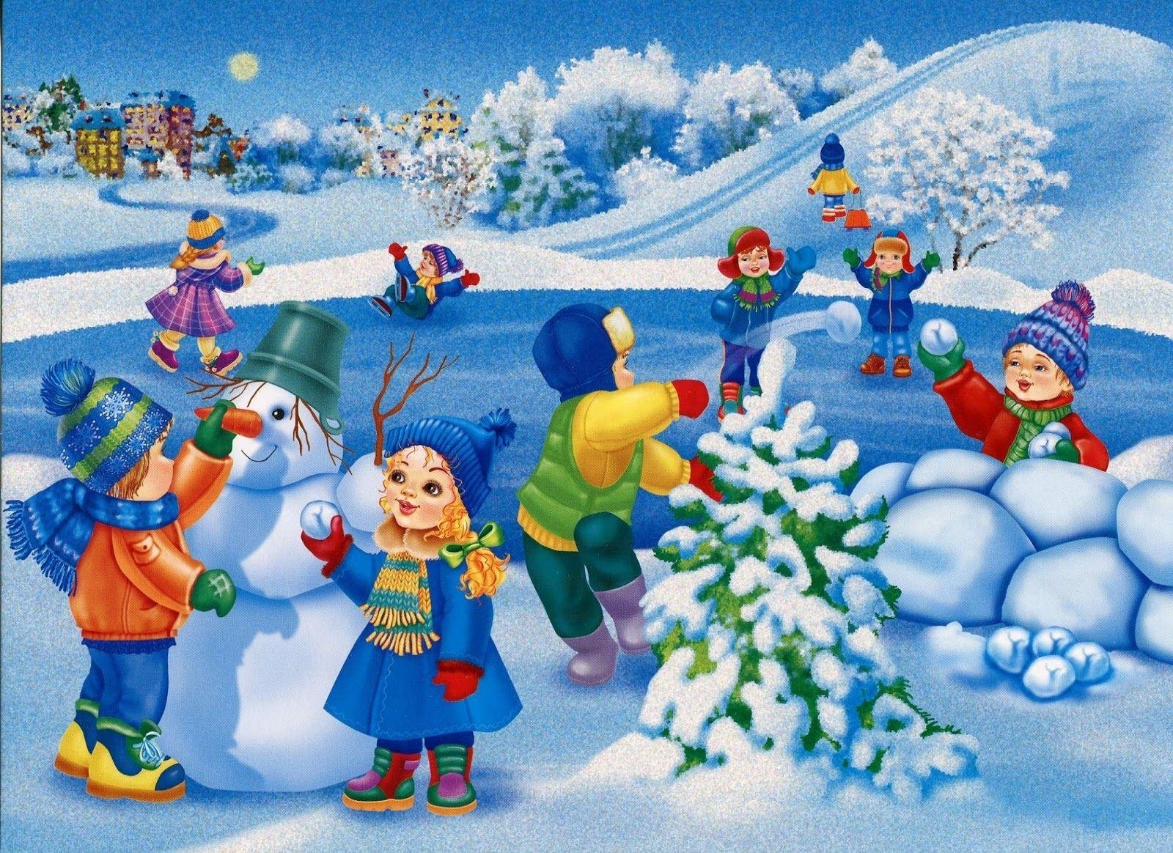
Answer: winter
back

