Slide 1
National-regional
component
in teaching English.
Tsydypova D.G.
the teacher of English

Slide 2
Basis School curriculum
Federal component
1-4 forms- 80%
5-9 forms-60%
10-11 forms-40%
It provides for the unity of the educational space on the territory of Russia and guarantees the graduates the getting of basic knowledge, skills and practice.
Regional-school component
1-4 forms-20%
5-9 forms-40%
10-11 forms-60%
It gives the opportunity to schools to introduce subjects where students can learn the history, customs and traditions of their region.

Slide 3
Foreign language
is included into federal component
realises regional-school component

Slide 4
Presentations and lessons on
NRC.
Books on
Buraytia by D.Z.
Munkozhapova
contests
National-regional
component
Summer
Linguistic
camp
projects
Scientific and research
activity

Slide 5
The aims of regional-school component
• to enlarge students’ knowledge about Buryatia, Kyakhtinsky district, lake Baikal and others ;
• to study history, customs , traditions of Buryatia;
• to form the feelings of respect to the traditions and customs of every nation, living in Buryatia.
• to bring up the culture of international communication, patriotism and tolerance.

Slide 6
Project “Welcome to Kyahkta”

Slide 7
Actuality
Russia is integrating into the world community and the problem of learning English for the purpose of communication is especially urgent today.
Learning of the regional component is very actual for people living in Kyakhta and Kyakhtinsky district as it is located on the Russian- Mongolian border and there is an international motor-way transition Kyakhta-Altan-Bulak. The 2013rd year is announced as the year of tourism in Buryatia.The information tourist centre is planned to be created in Kyakhta. It is neccesary to teach students not only to communicate with foriegners but to represent the history,traditions,customs of people living in Buryatia.

Slide 8
• Participants of the project : pupils of the 8th form.
• The aims of the project:
- to enlarge the pupils’ knowledge about Kyakhta and Kyakhtisky district;
- to teach to represent our district in English;
-to bring up the feelings of pride for our native land;

Slide 9
The first stage
● Suggestion of the themes.
●The choice of problems, problems of the project.
●The main task of the first stage is to include all the pupils into the work over the project, it is necessary to cause interest of every pupil.

Slide 10
The second stage.
1. Coordination of the general line o f the project. Forming of the groups. Making of the detailed plan of work on the project. Discussion of the ways to collect information and research work.
2. According to the number of the themes the class can be divided into 3-5 groups. Each group consisted of pupils with different language skills. The pupils visited Kyakhta , the museum by Obruchev, datsan “Baldan-Breibun.”After visiting Kyakhta the pupils wrote a composition “Sandy Venice” at the Russian lesson.

Slide 11
The themes of the project.
1. The history of Kyakhta
2. Sightseeings of Kyakhta.
3 .Datsan “Baldan-Breibun”
4. Resort “Kiran”
5. My native village “Bain-Bulak”

Slide 12
The third stage
●The defence of the projects.Discussion and analysis of the collected information.. Making booklets and posters. Preparing for the final lesson. Presentation of the project.
●The results were presented as plane-tables “ “The history of Kyakhta” , datsan ‘Baldan-Breibun” ,booklets-advertisments Resort “Kiran”, invitation-advertisement “Welcome to Bain-Bulak”, “Surkharban”,virtual excursion to local historical museum in Kyakhta at the final lesson

Slide 13
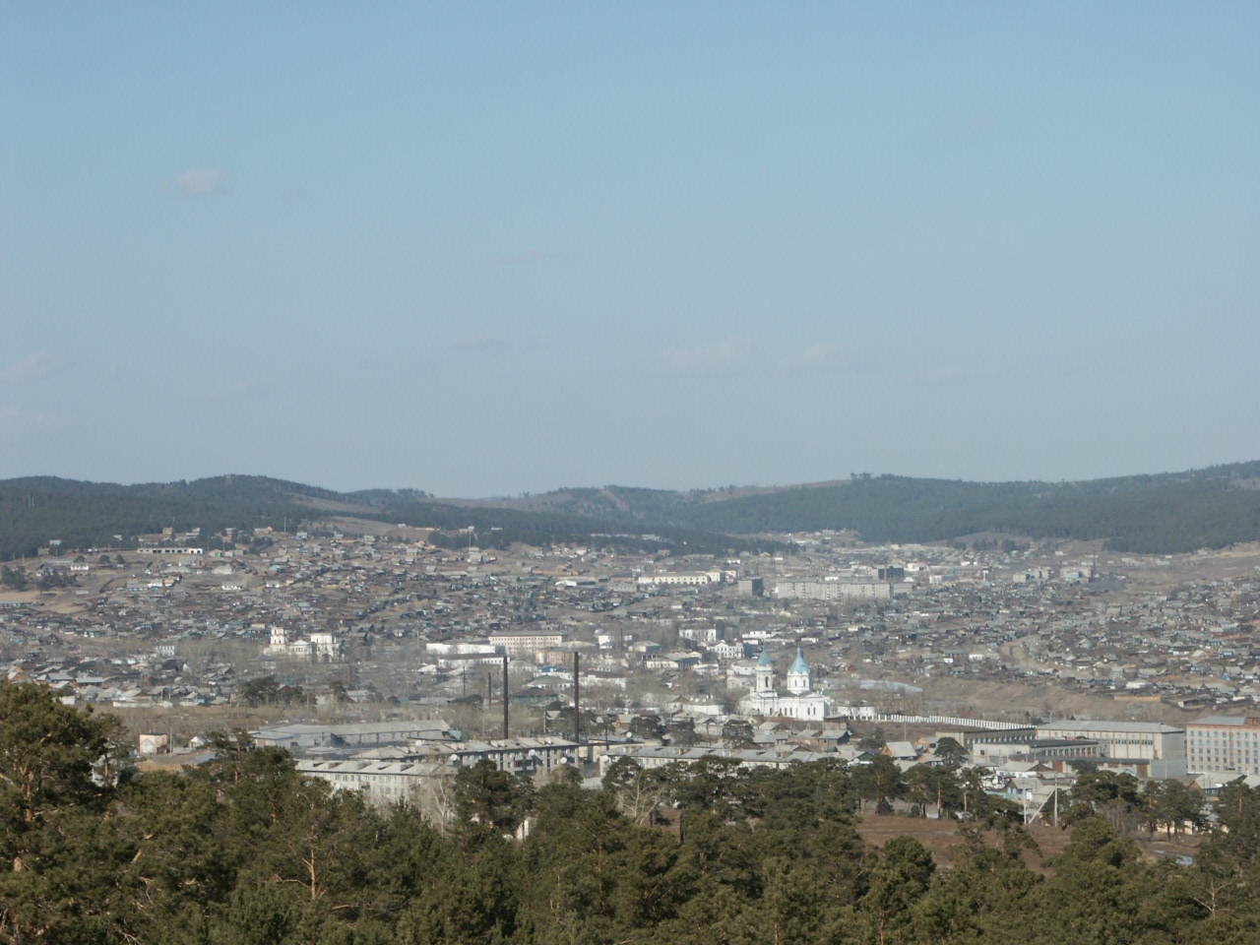
Welcome to Kyakhta

Slide 14
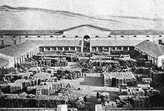
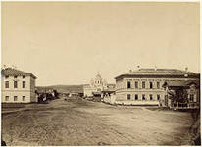
The history of Kyakhta.
Kyakhta is an ancient town on the Russian- Mongolian border in the south of republic Buryatia.The prehistory of Kyakhta - Troitskosavsk began in the times of Peter I . He sent the diplomatic mission with F.A. Golovin and a treaty in Nerchinsk in 1689 was signed, but it had no results. 30 years later Katherine I sent a new embassy to the Chinese border with Savva Lukich Vladislavich-Raguzinsky at the head, the Burinsky treaty was signed in 1727. The New Trinity fortress, designed by Raguzinsky,was built on the river Kyakhta in 1727 and so the history of Troitskosavsk began.

Slide 15
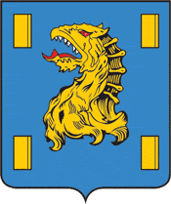
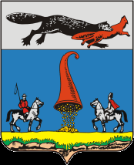
Kyakhta’s coat of arms.
From the oldest times the towns and cities had their own symbols. So Kyakhta and Troitskosavsk had their coats of arms.
Coat of arms of Kyakhta is an azure shield with an alienated head of dragon and 4 golden shingles. The Chinese consider 3-headed dragon as the sign of trade and golden shingles mean gold ingots. In old times the Europeans believed that dragon was the symbol of horror and evil.
In Russia dragon was known as a snake and wicked forces opposed Russia.
Coat of arms of Troitskosavsk is also a shield where you can see two horsemen- the Cossack and the Buryat, horn of abundance and ermine with a fox in the mouth. We can suppose that ermine with fox meant “Fur trade” which made Troitskosavsk rich. Horn of abundance was a symbol of prosperity.

Slide 16
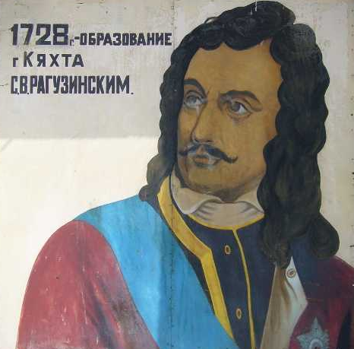
Savva Lukich Vladislavich- Raguzinsky
(1669-1737).
Savva Raguzinsky, the founder of Kyakhta, was the Serb from the old Bosnian princely family in Raguza. His main activity was trade in Constantinopol. He was the secret agent of Russian ambassadors in Constantinopol.
In 1708 Raguzinsky moved in Russia, he was given a mansion in Moscow and 3 villages in Ukraine for his service to Russia. Peter I made him outhouse adviser and Katherine I awarded him the rank of State adviser for his merits and devotion to Russia. Thanks to Savva Raguzinsky a new treaty with China, Burinsky treaty , then Kyakhtinsky treaty were signed and the history of Russian- Chinese trade began.
Russia became the second Motherland for Raguzinsky, he devoted most of his life to Russia and its prosperity. He was awarded by the Order of Alexander Nevsky for his diplomatic activity.
Savva Vladislavich – Raguzinsky died in St. Petersburg in 1738.

Slide 17
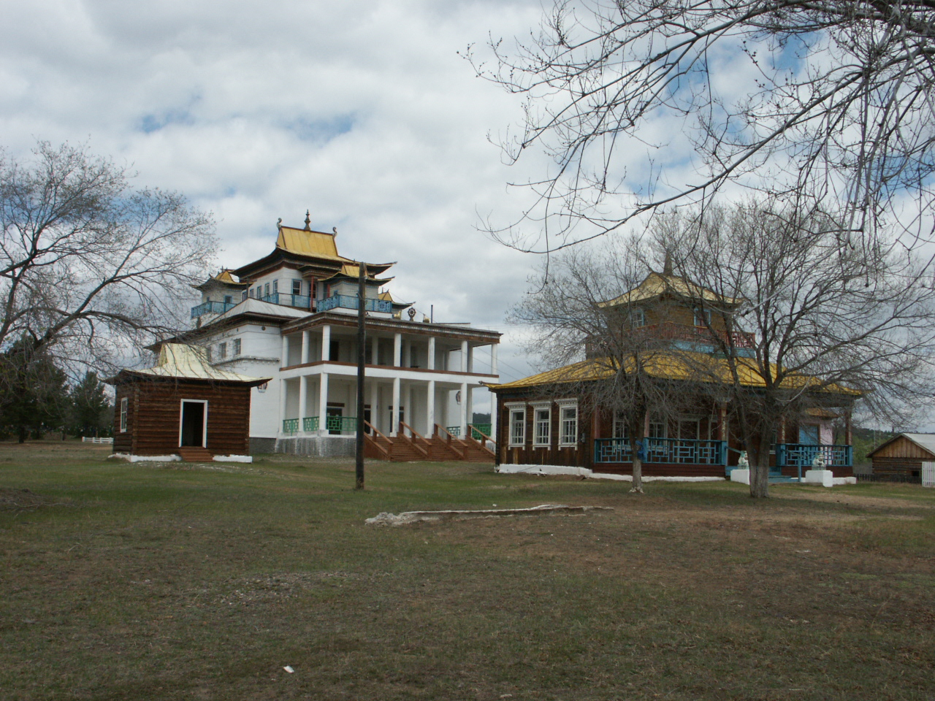
Datsan
“ Baldan-Breibun”
Datsan”Baldan-Breibun” is the oldest Buddhist temple on the territory of Russia. Datsan was built in 1741 , since that time Buddhism has become the state religion in Russia. In 1991 our republic celebrated the 250-th anniversary of buddhism in Russia.
Datsan is situated not far from the village Murochy,on the right bank of the Chikoy, 60 km. far from Kyakhta.

Slide 18
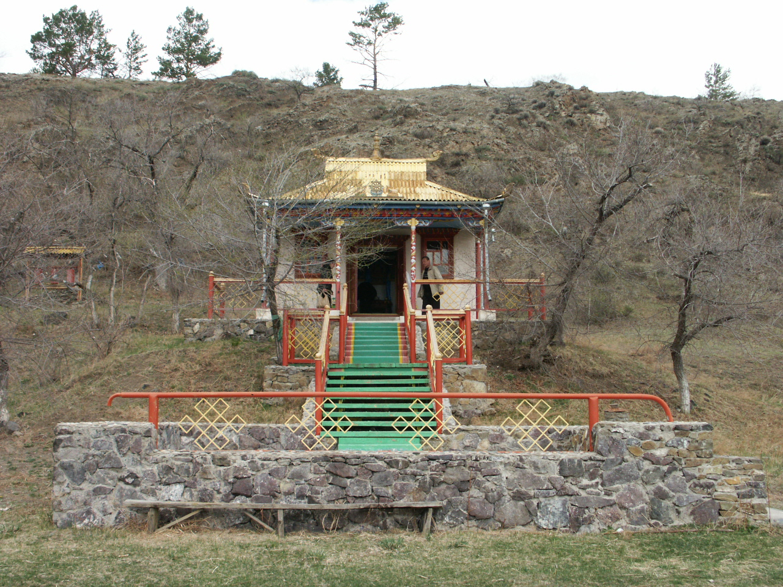
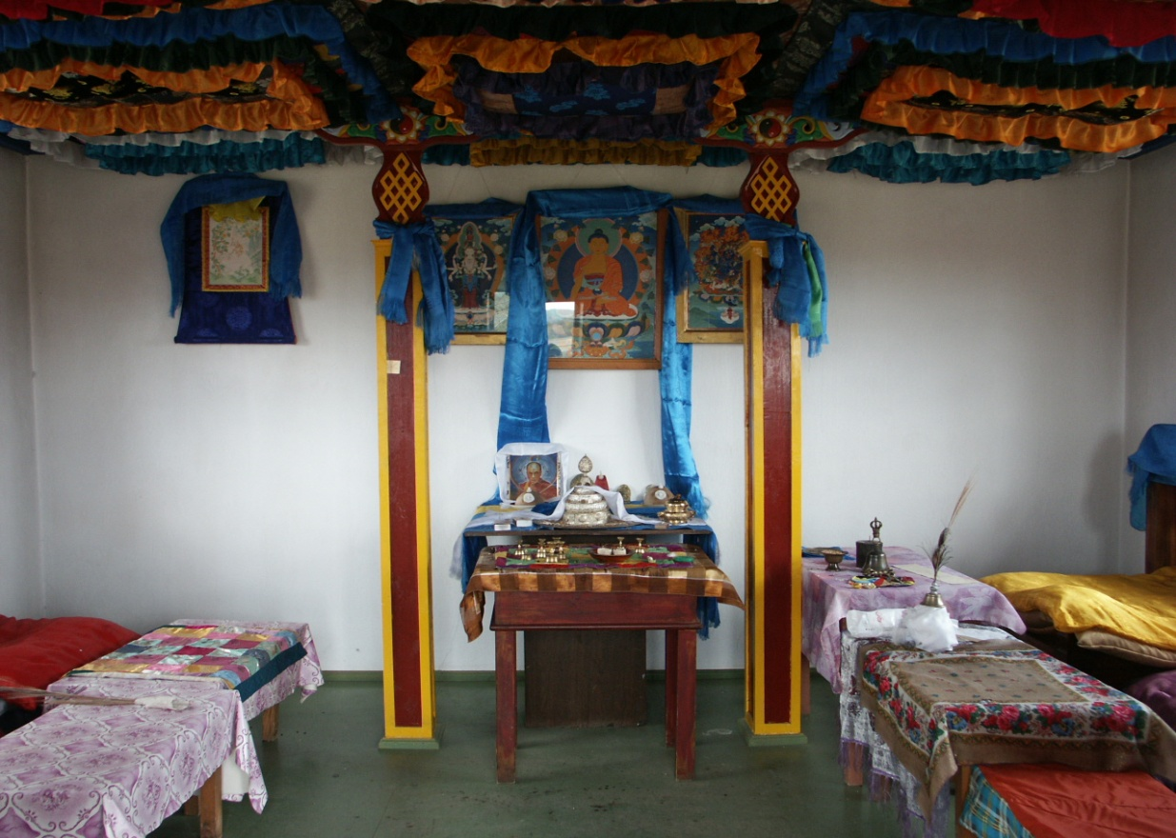
Dugan near Arangin-Aryabala

Slide 19
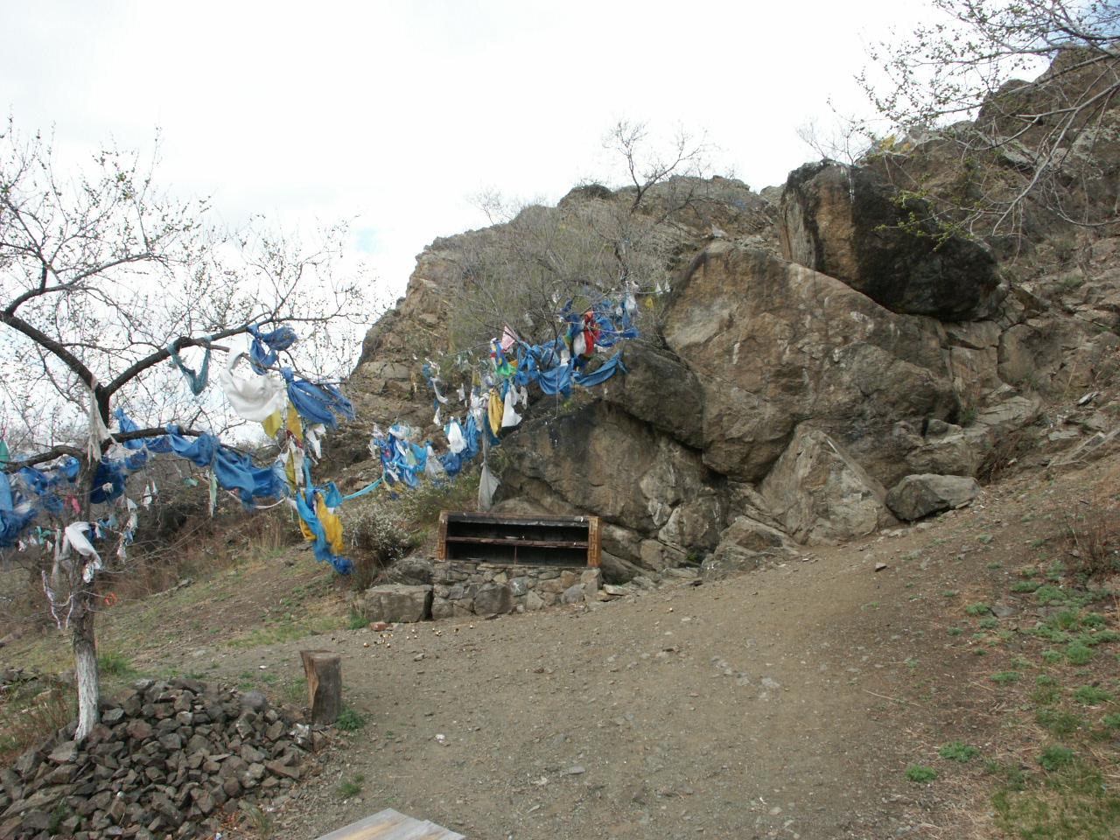
Sacred rock Arangin-Aryabala
Not far from the datsan Baldan-Breibun you can find one of the two sacred places in the world “ Arangin Aryabala”. You can see the words of buddhist prayer on the rock. They say that it is the “ Sign of Buddha”, it was discovered two hundred years ago.
The second sacred place is situated in Nepal.
Prayers are held every year near this place, a lot of people come to pray.

Slide 20
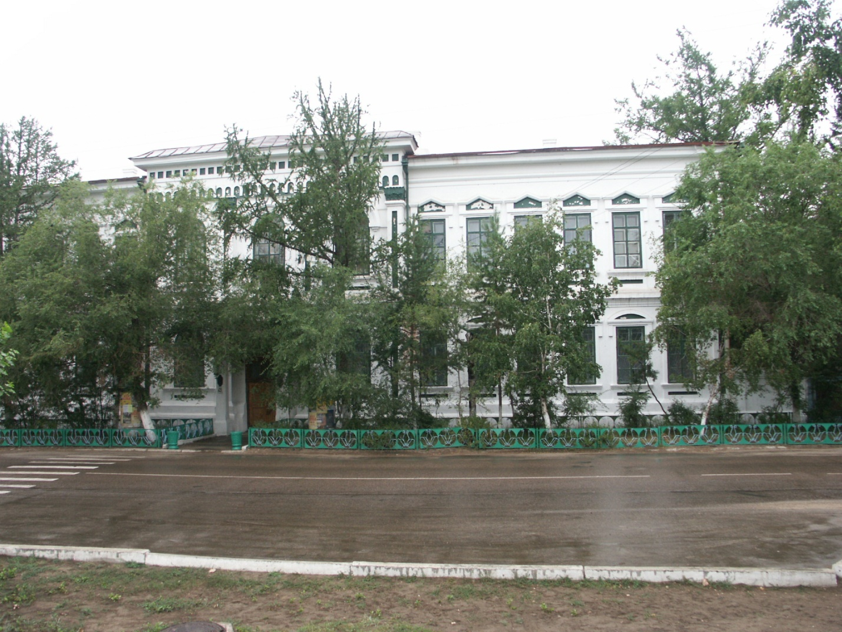
The local History museum by name V.A.Obruchev.
The local History museum is a unique due to its history and exhibits.
Do you know who was the museum founded by? When was it founded? It was founded in 1890. The teachers of the real secondary school, woman gymnasium and representatives of the local intelligentsia promoted the opening of the museum. The first collection consisted of 310 exhibits. There are 13 departments: ethnographical, archeological, historical, anthropological, natural history, numismatics and etc.
I think we must be proud of our History museum, it’s a treasure of unique exhibits. There is no such a museum in Buryatia.

Slide 21
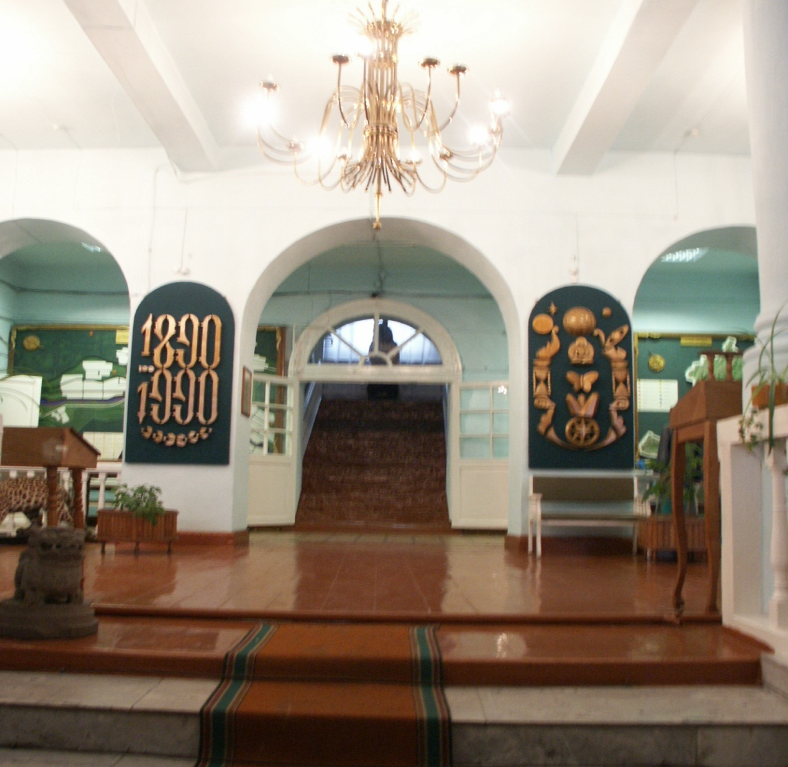
The foyer of the museum

Slide 22
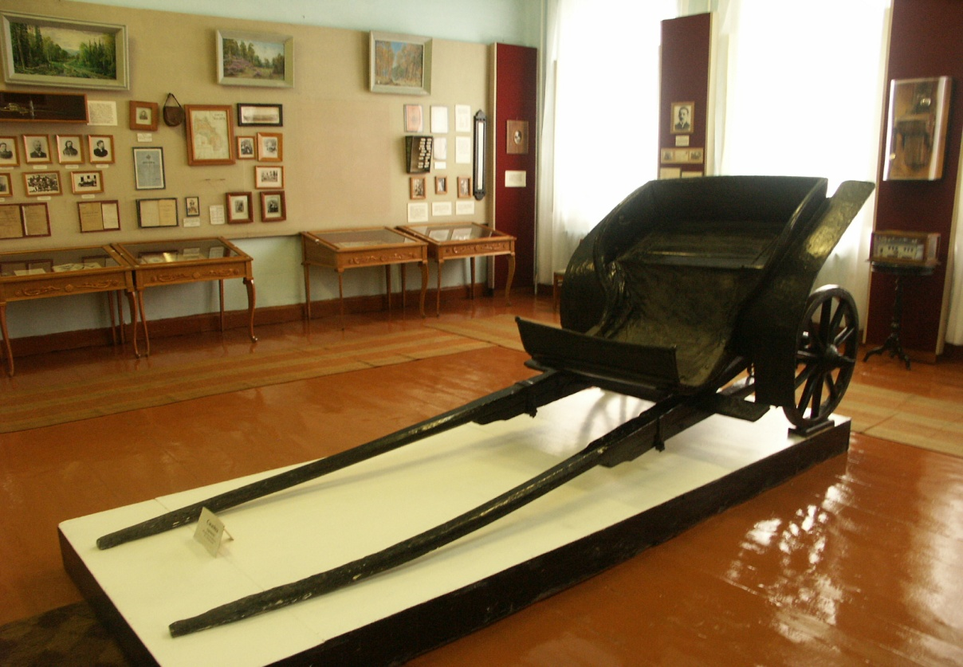
“The activity of Russian geographical society”

Slide 23
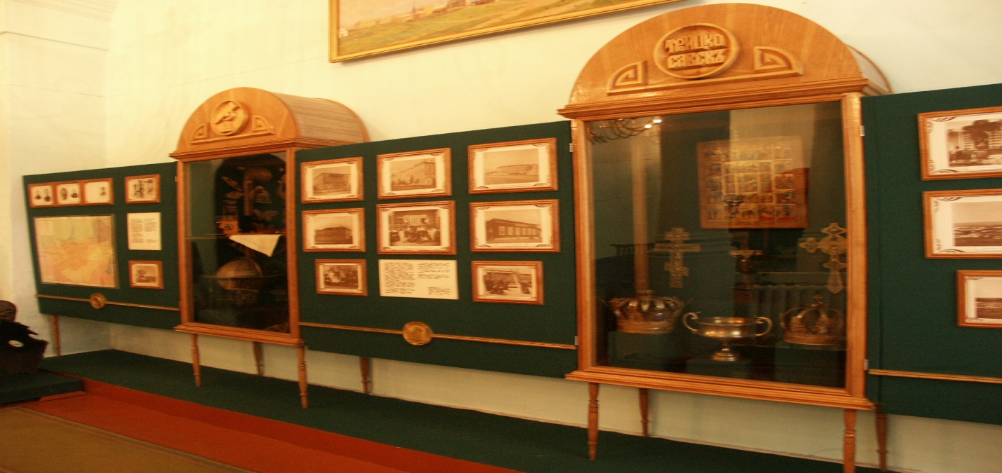
Introductory complex.

Slide 24
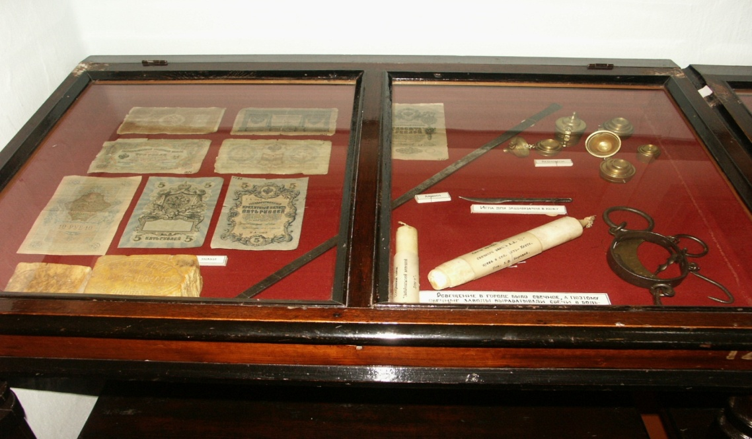
The history of trade

Slide 25
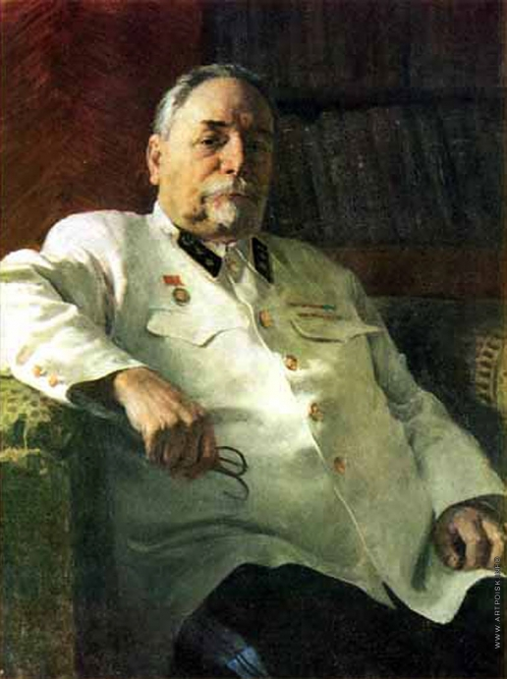
Obruchev Vladimir Afanasyevich
(1863-1956)
Do you know why the museum got the name after V.A.Obruchev? What was he famous for?
V.A. Obruchev was a famous Russian geologist and geographer, who explored Mongolia, China, Altai, the south-east of Zabaikalye. He is an author of many scientific works: “ The geology of Siberia” , “The history of geological exploration of Siberia” and others. V.A. Obruchev is also famous for his science- fiction books as “Plutonia” , “ The Sannikov’s land” .
He visited Kyakhta for the first time in 1892 on his way to China, when he took part in the expedition of G.N.Potanin as a young engineer. Later Obruchev visited Kyakhta several times, he organized his own expeditions to Mongolia, China and Zabaikalye. Then he became the honoured member of Troitskosavsk Russian geographical society. He sponsored and supported the museum when it had difficulties. The scientist helped the History museum of Kyakhta during all his life, he granted the museum a wonderful collection of mountain rocks.(горные породы)
In 1940 , when the museum was 50, it was named after academician V.A. Obruchev.

Slide 26
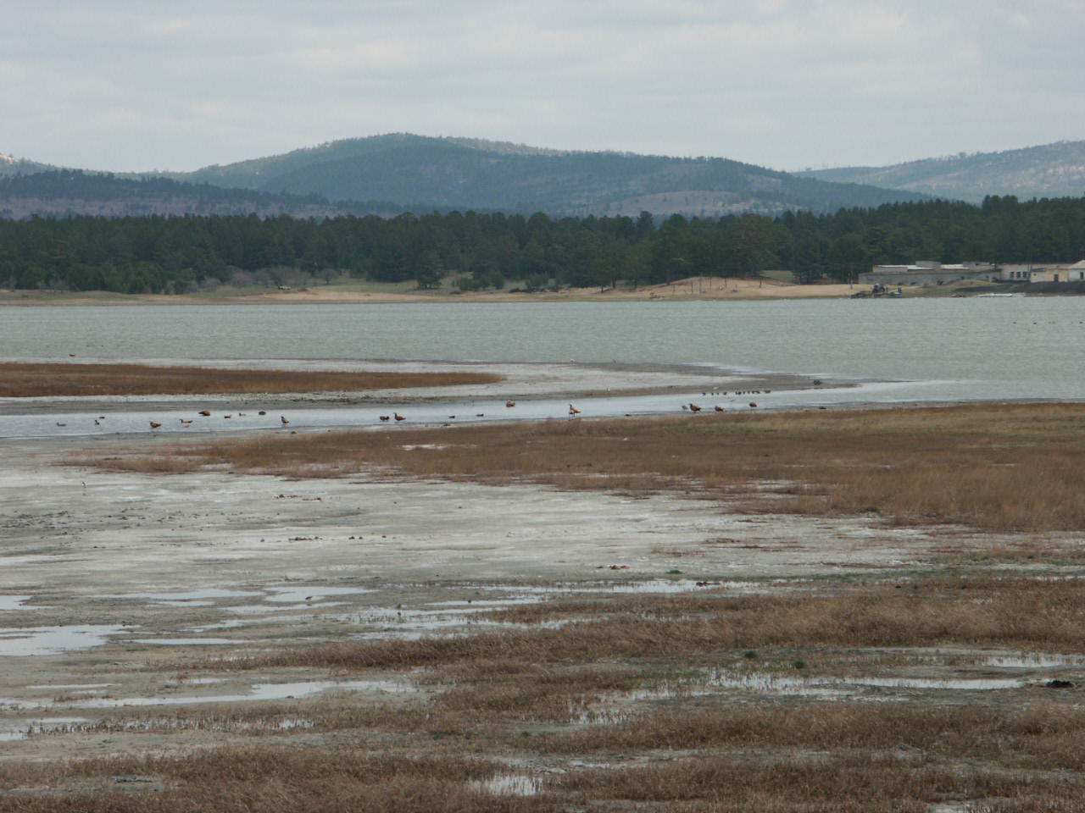
Resort “Kiran”

