Slide 1
Family ties

Slide 2
Let’s practise our sounds
[w] – what, where, when, why, which, want
[ ɛə] – fair, hair, caring, where, there.

Slide 3
Say in different words
your father and your mother are your
your mother’s father is your
your father’s mother is your
your father’s sister is your
your mother’s brother is your
your aunt’s and uncle’s children are your
your brother’s daughter is your
your sister’s son is your
your mother to your father is his
your father to your mother is her
Parents Niece Husband Grandmother Uncle Grandfather Wife Cousins Nephew Aunt

Slide 4
The Imperative
Commands: Be quiet! – Тише!
Instructions: Press the red button. – Нажмите красную кнопку.
Offers(предложения): Have some juice. – Возьмите немного сока.
Don’t open the window, please. - Не открывайте окно,пожалуйста.
close the window (+) write (-) clean the room (+)
stand up (-) read loud (+) talk at the lesson (-)

Slide 5
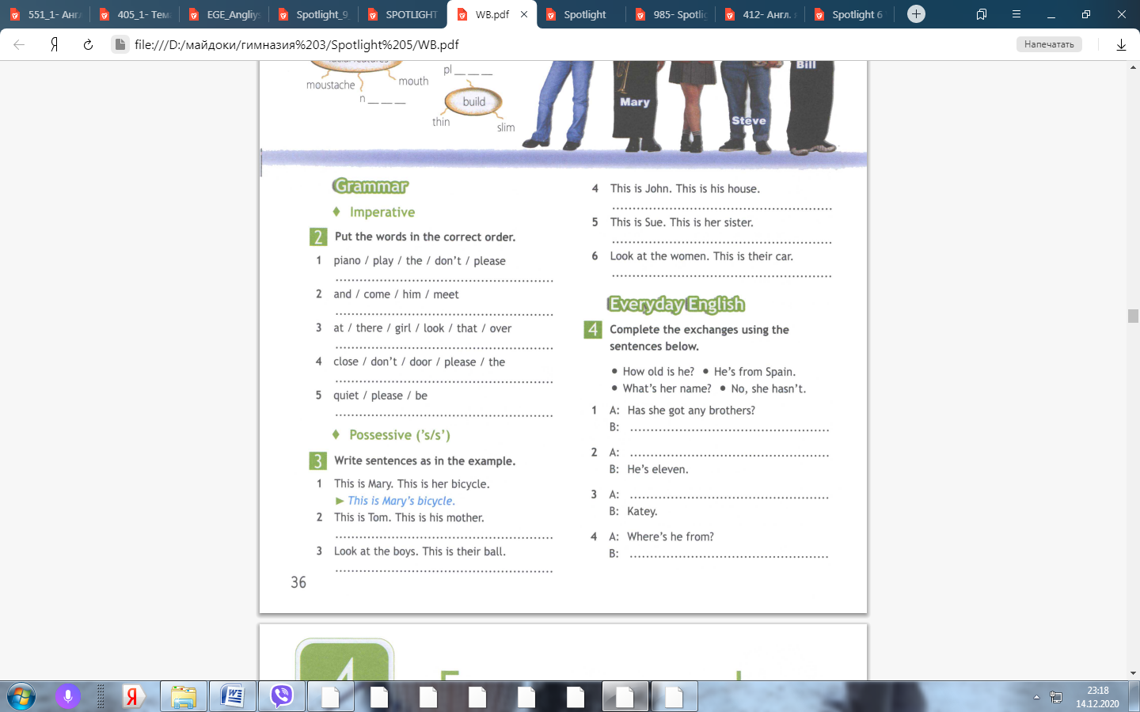
Put the words in the correct order

Slide 6
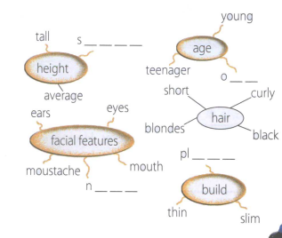
Finish the spidergrams

Slide 7
Use the example to speak
My mother’s/father’s name is…. .
She/He is …years old.
She/He is … (a teacher, a doctor, a housewife, a shop-assistant, a driver, a worker, a manager).
She/He is (tall/short of medium height/ thin, plump).
She/He has got ….(….eyes,…. hair, a…..nose).
She/He can…….. .
My mother/father is … (kind, loving, nice, caring, cool,funny …).
I love him/her very much.

Slide 8
Use the plan to speak
What’s his/her name?
How old is she/he?
What does he/she do?
What does he/she look like?
What can he/she do?
What is he/she like?

Slide 9
Homework
Revise vocabulary 4a-4d
Write the description of two family members using the plan.

