Slide 1

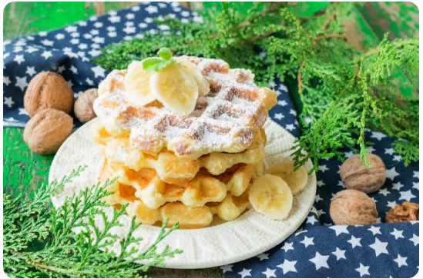
Cottage Cheese Waffles

Slide 2
Ingredients
Cottage cheese-200 grams
Butter-180 grams
Whole wheat flour-250 grams
Sugar-150 grams
Egg-2 pieces
Baking powder-1 teaspoons
Baking soda-0.25 teaspoons
Vanillin-1 pinch
Corn starch-50 grams
Salt-1 pinch

Slide 3

Steps
In a bowl mix softened butter, sugar and vanillin.

Slide 4
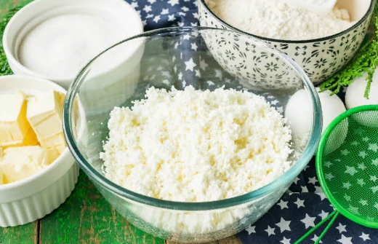
Steps
Grate cottage cheese through the sieve.

Slide 5

Steps
Add cottage cheese to the butter and sugar. Mix with a mixer .

Slide 6

Steps
Add two chicken eggs to the mixture. Mix with the mixer.

Slide 7
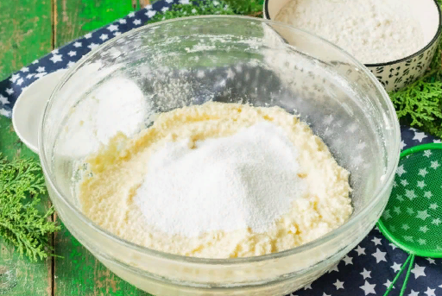
Steps
Then add corn or potato starch, soda, baking powder, a pinch of salt and vanillin.

Slide 8
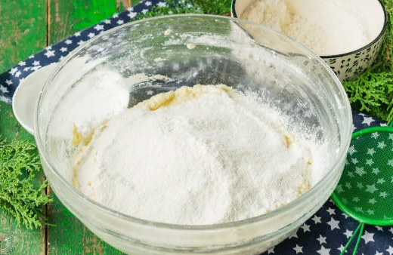
Steps
Add wheat flour and mix the ingredients.

Slide 9

Steps
The finished dough should be thick enough and hold on a spoon.

Slide 10
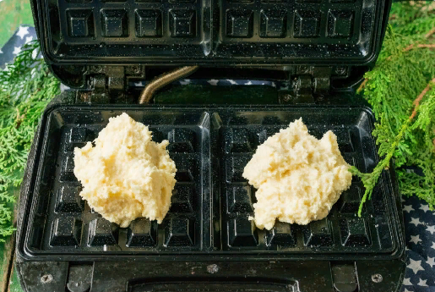
Steps
Pre-heat the electric waffle maker and grease its sheets with vegetable oil. Put one tablespoon of cottage cheese dough.

Slide 11
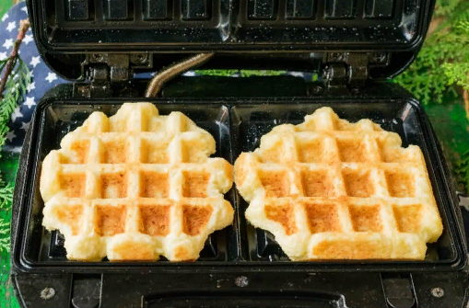
Steps
Close the electric waffle maker and bake waffles until golden brown for 3-5 minutes.

Slide 12

Steps
Serve the ready cottage cheese waffles with tea or coffee. Add your favorite toppings.

