Slide 1
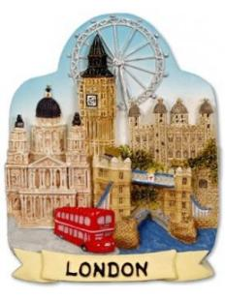
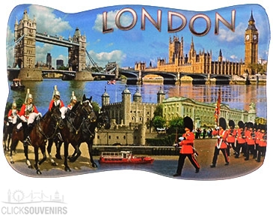
Игра-путешествие по английскому языку
для учащихся 5-7 классов
Тема: «Экскурсия по Лондону»
Разработала
учитель английского языка
МОУ СОШ №5
Баранникова Валентина Ивановна

Slide 2
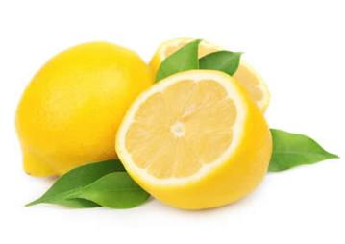
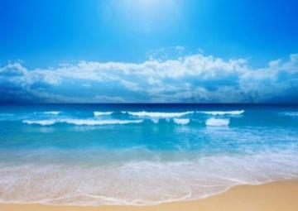

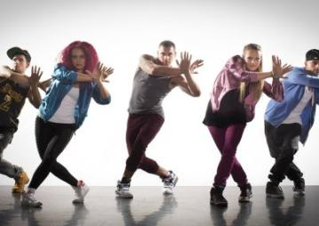
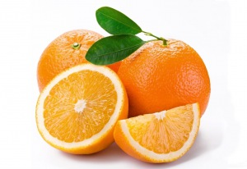
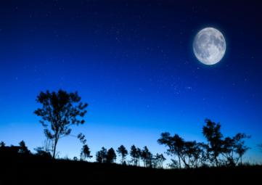
Use the first letters of the names of the things you see in the pictures and you will know what city we are going to travel
1
2
3
N
L
eck
emon
O
cean
4
5
6
D
O
N
ance
range
ight

Slide 3
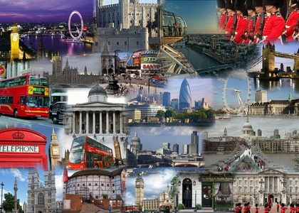
Тravelling Game
‘Round London’

Slide 4
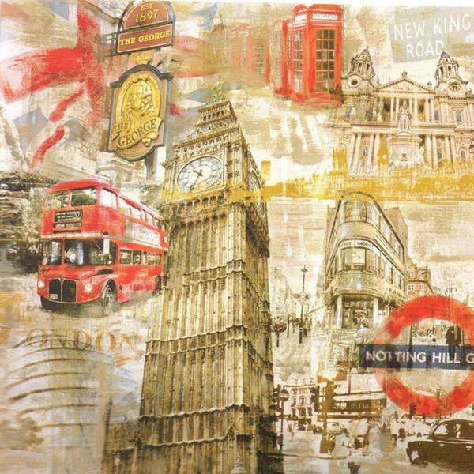
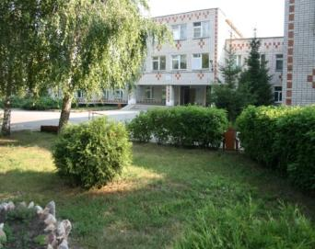
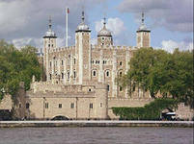
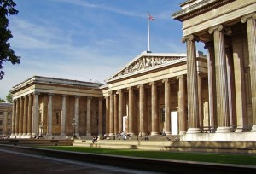
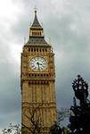
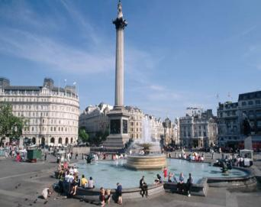
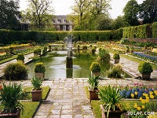
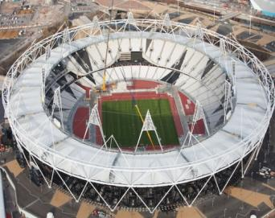
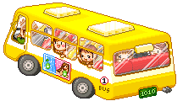
History
Museums
Map of
travelling
Traditions
Monuments
Sports
Parks

Slide 5
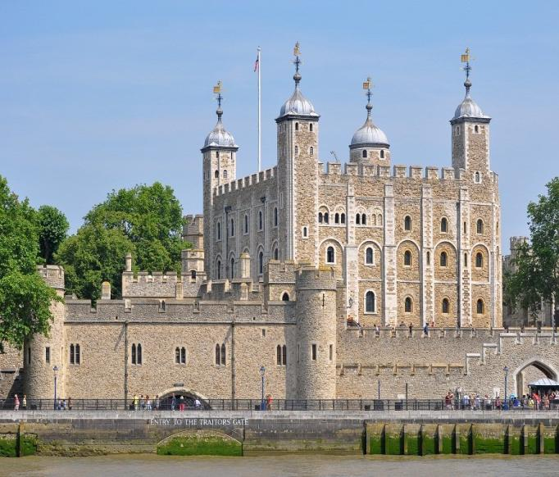
Bus Stop No.3
History

Slide 6
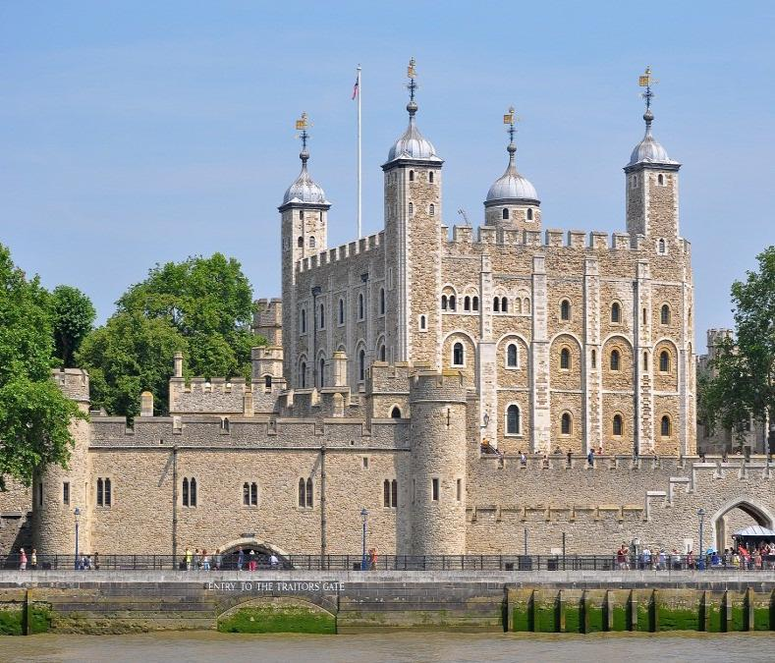
It is more than 900 years old
It consists of 20 towers
In the past it was a palace and a prison (тюрьма)
Now it is a museum
It’s a home of the Crown Jewels and national treasures
9 ravens resides (обитают) at the tower
Tower of
London

Slide 7
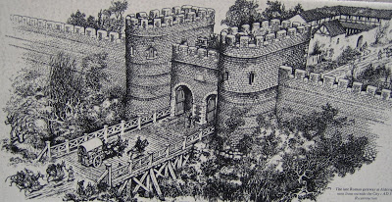
History
… gave the name Londinium to the small town.
A. The Anglo-Saxons
B. The Romans
C. The Normans

Slide 8
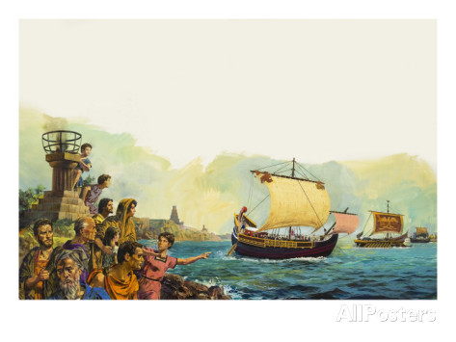
History
2. The Romans left Britain about … years ago.
A. 2,000
B. 1,000
C. 100

Slide 9
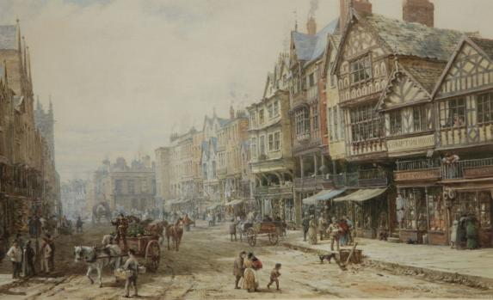
History
3. In the 11th century people of London usually built the houses from … .
A. stone
B. sand
C. wood

Slide 10
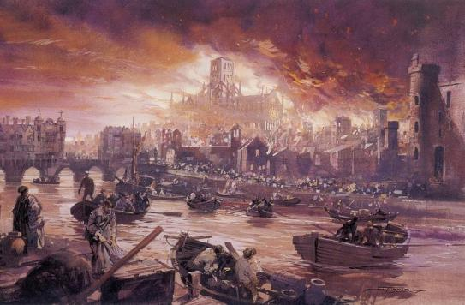
History
4. In 1666 the year of the … of London.
A. Great Fire
B. Great History
C. Great Ghanges

Slide 11
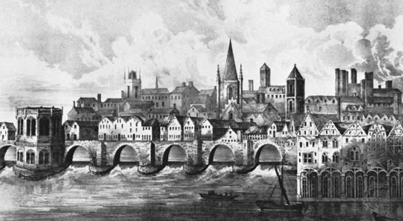
History
5. Until 1749 there was only one bridge across the river Thames. Its name was … .
A. Westminster Bridge
B. Tower Bridge
C. London Bridge

Slide 12
Bus Stop No.6
Museums

Slide 13
It was founded in 1753
It tells us about history of people and culture
It has unique collections of maps, coins, medals, stamps, ceramics, prints and drawings, etc.
It has nearly 8 million objects in its collection
It has one of the largest libraries in the world – the British Library
The British
Museum

Slide 14
Museums
A. It is an art museum which has more than 2,300 paintings
1) Imperial War Museum
B. In this museum you can see the wax models of great characters in history and art
2) National
Gallery
C. It is famous for its exhibition of dinosaur skeletons. It has five main collections: botany, entomology, mineralogy, paleontology and zoology
3) Natural History Museum
D. It has a big collection of military machines such as tanks and aeroplanes and many original uniforms of soldiers
4) London Transport Museum
5) Madam Tussaud’s Museum
E. From uniforms, posters and tickets to
horse buses, electric trams and trolley buses – all these things you can find in this museum

Slide 15
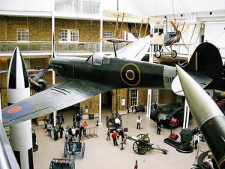
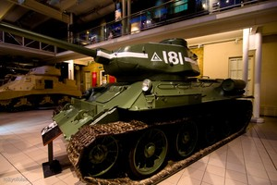
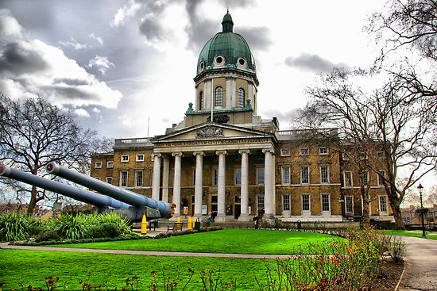
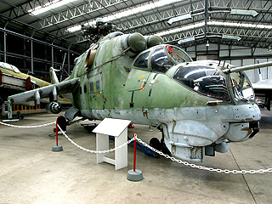
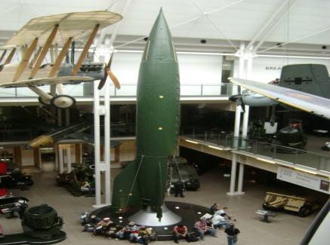
Imperial War Museum

Slide 16
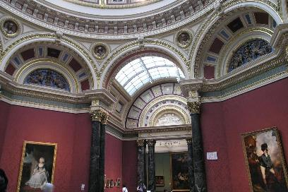
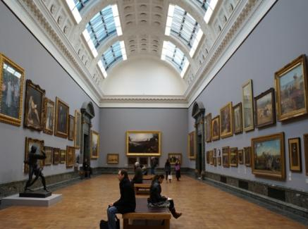
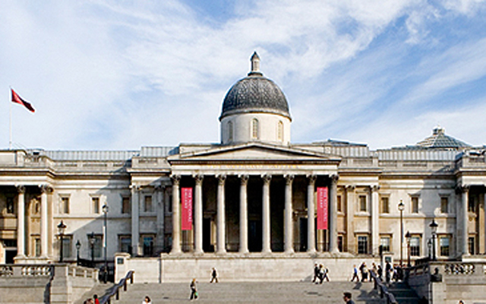
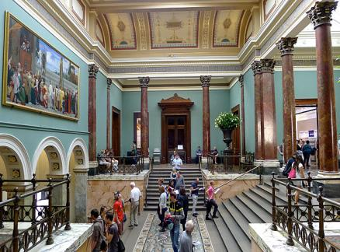
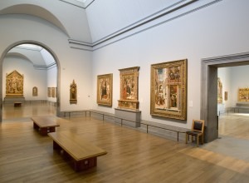
National Gallery

Slide 17
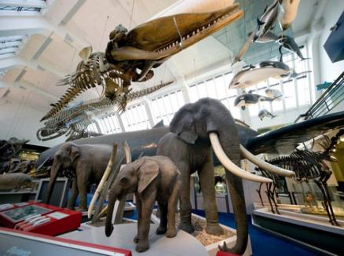
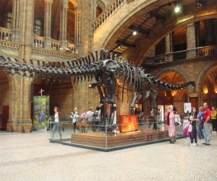
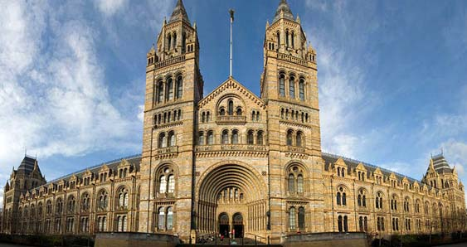
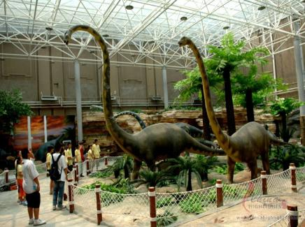
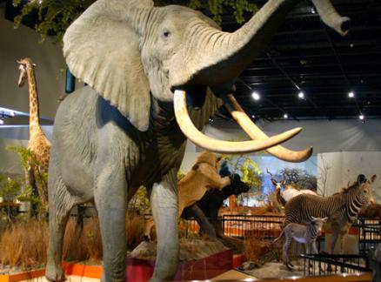
Natural History Museum

Slide 18
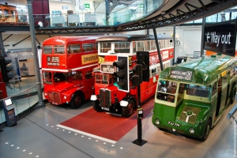
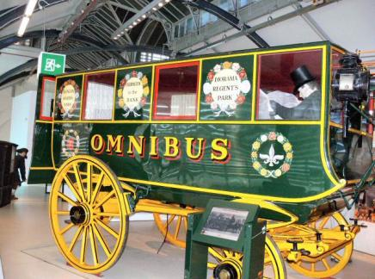
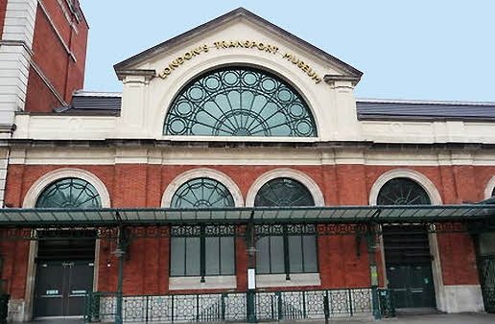
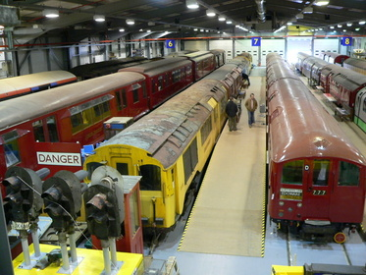
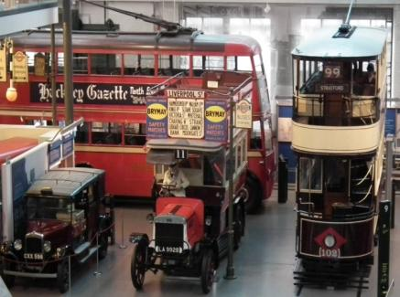
London Transport Museum

Slide 19
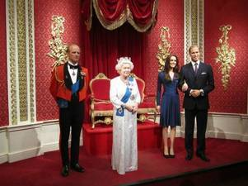
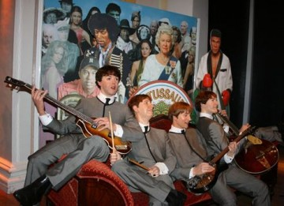
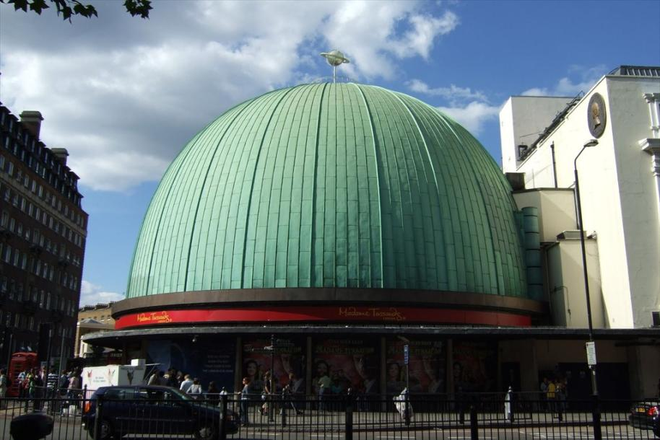
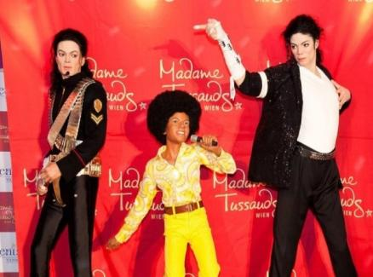
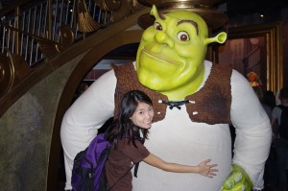
Madam Tussaud’s Museum

Slide 20
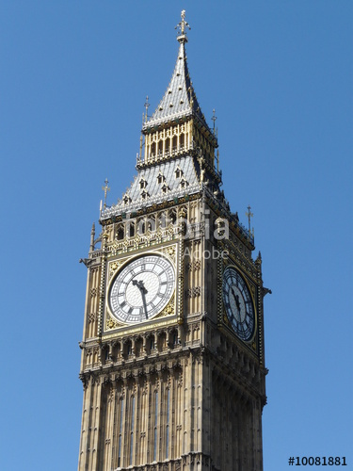
Bus Stop No.2
Monuments

Slide 21
It’s the symbol of the United Kingdom
It’s the most popular landmark in Great Britain
It’s the main clock in the UK
You can hear the deep boom of it on the BBC channel
It weighs 13,720 kilograms
Big Ben

Slide 22

Monuments
Tower Bridge
Westminster
Abbey
Tower
Bridge
The Tower of
London

Slide 23

Monuments
Buckingham Palace
Piccadilly
Circus
Buckingham
Palace
Whitehall

Slide 24

Monuments
St Paul’s Cathedral
St Paul’s
Cathedral
Tate Picture
Gallery
Queen Victoria
Theatre

Slide 25

Monuments
Houses of Parliament
Speaker’s
Corner
Houses of
Parliament
Nelson’s
Column

Slide 26

Monuments
Westminster Palace
Westminster
Abbey
The ‘Globe’
Theatre
National
Gallery
Westminster
Palace

Slide 27

Bus Stop No.5
Sports

Slide 28

It was built for the 2012 Summer Olympic and Paralympic Games
It has 80, 000 seats
50 km – the seats lined side by side
It is half the size of the London Eye
It will host the 2017 Athletics World Championships
Olympic Stadium
(London Stadium)

Slide 29
Sports
l
a
l
o
f
b
o
t
f
o
o
t
b
a
l
l
It is the most popular sport in the United Kingdom

Slide 30

Football
It is a national sport in Great Britain. Football is played every Saturday or Sunday afternoon. There are a lot of football clubs in the UK. For example, Manchester United or Arsenal. Almost every school has its football team. Every boy knows a lot about this game and can tell you the names of the players in the most popular football clubs.

Slide 31
Sports
y
b
u
r
g
r
u
g
b
y
It is a type of football which
is played with an oval ball

Slide 32

Rugby
It is a type of football. It began in Rugby School in England. It is played with an oval ball. The ball is passed from hand to hand. It is played by two teams of 15 players each.

Slide 33
Sports
n
e
t
i
s
n
t
e
n
n
i
s
It is sport which is
famous for Wimbledon

Slide 34

Tennis
It is another favourite sport of the English people. Wimbledon is the centre of tennis. It is the oldest tennis competition in the world. It is held over two weeks in late June and early July. Every tennis player dreams of taking part in this world championship. It is very prestigious to be the winner in Wimbledon.

Slide 35
Sports
i
k
r
c
t
r
e
c
r
i
c
k
e
t
It is a very long game which is very popular in summer

Slide 36

Cricket
It is a popular summer sport in Great Britain. Cricket players wear a certain uniform – white boots, a white T-shirt and white trousers. There are two teams of 11 players. It’s a very long game – it can last up to 5 days. It is often played in schools, colleges and universities.

Slide 37
Sports
l
g
f
o
g
o
l
f
It is popular among
business people

Slide 38

Golf
It is a game of business people. If you want to have good relations in business you must play in it. It comes from Scotland. Golf is a ball and golf stick game played on a natural field. A person should knock a ball into a hole. It is played all the year round.

Slide 39

Bus Stop No.4
Parks

Slide 40
It’s the largest London park
It is famous for its Speaker’s Corner
It’s a place for political meetings, celebrations and concerts
Serpentine Lake is the main attraction in it
There is a memorial installed in honor of princess Diana in it
Hyde Park

Slide 41
Parks
1
?
2
?
3
?
4
?
5
?
Parks which are the property of the Queen’s family are called … Parks

Slide 42

Parks
1
n
a
t
u
r
e
2
3
4
5
1. Richmond Park is a national … reserve and a deer park.

Slide 43

Richmond Park

Slide 44

Parks
1
n
a
t
u
r
e
2
z
o
o
3
4
5
2. In Regent’s Park you will find London … .

Slide 45


Regent’s Park

Slide 46

Parks
1
n
a
t
u
r
e
2
z
o
o
3
d
a
y
s
4
5
3. On fine summer … Green Park is very popular for sunbathing and picnics.

Slide 47

Green Park

Slide 48

Parks
1
n
a
t
u
r
e
2
z
o
o
3
d
a
y
s
4
s
t
a
t
u
e
5
4. The … of the famous fairy-tale hero Peter Pan you can see in Kensington Gardens.

Slide 49

Kensington Gardens

Slide 50

Parks
1
n
a
t
u
r
e
2
z
o
o
3
d
a
y
s
4
s
t
a
t
u
e
5
p
a
l
a
c
e
5. St James’s Park is very beautiful with the view of Buckingham … .

Slide 51

St James’s Park

Slide 52
Parks
1
n
a
t
u
r
e
2
z
o
o
3
d
a
y
s
4
s
t
a
t
u
e
5
p
a
l
a
c
e
Parks which are the property of the Queen’s family are called Royal Parks

Slide 53

Bus Stop No.1
Traditions

Slide 54
It’s a geographical centre of London
It is named after the Battle of Trafalgar on 21 October 1805
It’s a centre of annual celebrations on New Year's Eve
A Christmas ceremony has been held in the square every year since 1947
Trafalgar Square

Slide 55

Traditions
1. On Easter many people in Britain go to ______
church

Slide 56

Traditions
2. British people often sing a special song “Auld Lang Syne” when they celebrate ________
New Year

Slide 57

Traditions
3. People celebrate St Valentine’s Day on _____________
February, 14 th

Slide 58

Traditions
4. During Halloween children often come to their neighbours’ doors and say “____________”
Trick or Treat

Slide 59


Traditions
5. On ___________ a man or a woman reads the poem “Address to a Haggis” and only after that eat the dish with vegetables.
Burn’s Night

Slide 60

“When a man is tired of London, he is tired of life…”
Samuel Johnson,
the English writer

