Slide 1

My favourite food

Slide 2


I scream, you scream,
We all scream: “Ice-cream!”.
One, two, three, four,
Yummy chocolate give me more!
Five, six, seven, eight,
My favourite food is chocolate!

Slide 3
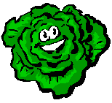
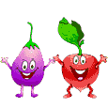
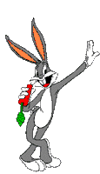
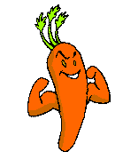
Favourite food

Slide 4
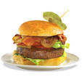

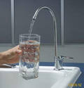
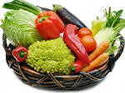
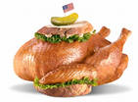
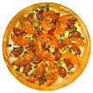


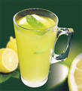


Slide 5
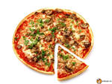
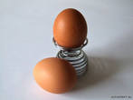
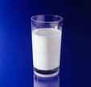
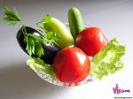
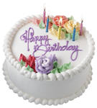
f
Eggs
Milk
Pizza
Cake
Vegetables
o
n
t
m

Slide 6
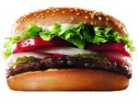
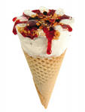
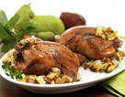
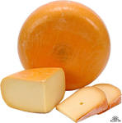
Chickens
Chocolate
Burgers
Cheese
Ice cream
a
e
c
b
d

Slide 7
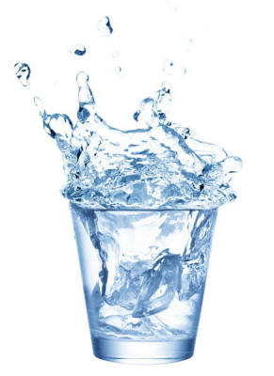
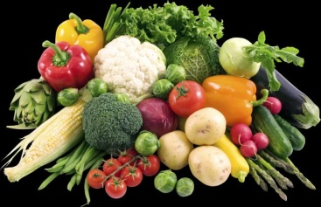
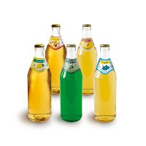
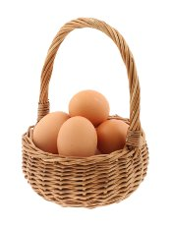
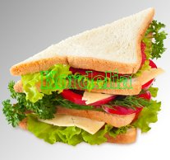
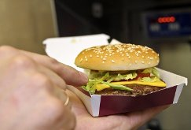
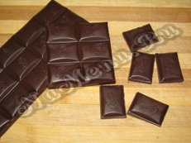
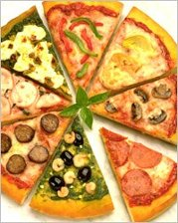
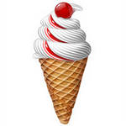
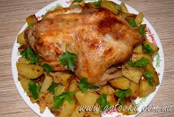
Listen and sing along
Chicken with vegetables,
Ice cream and chocolate.
Water and lemonade,
Pizza with cheese on it!
Eggs in my sandwiches,
Burgers with chips:
These are just some
Of my favourite things!

Slide 8

Present Simple Tense
+
We like milk. He likes pizza.
?
Do we like milk? Does he like pizza?
Yes, we do. Yes, he does.
No, we do not. No, he does not.
don’t doesn’t

Slide 9
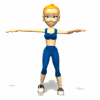

Отдыхаем…
Up and Down
Up and down, up and down
Clap your hands and turn around.

Slide 10

Choose the correct verb ( Do / Does)
Do/Does she like hot milk?
Do/Does they eat cheese every day?
Do/Does we often buy chips?
Do/Does it like meat?

Slide 11
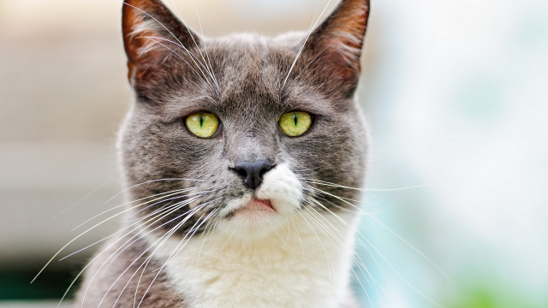
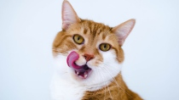

Name | vegetables | ice cream | water
Tom | x | v | x
Sam | x | x | v
Does Sam like … ?
Yes, he does. (No, he doesn’t)
Does Tom like … ?
Yes, he does. (No, he doesn’t)

Slide 12


Homework
S. b. p 44 ex 2
W. b. p 23 ex 3, 4

Slide 13

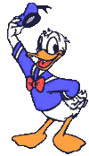

Not very good
YOUR MARK
Very good

Slide 14

Thank you for the lesson.

