Slide 1
Выполнил: Немальцев Виталий
Т/о «Диалог культур»
МБУДО ЦРТД и Ю ДДТ поселок Чульман.
Педагог: Ланкина Наталья Львовна
Notes:
11/2/2020
1
1

Slide 2
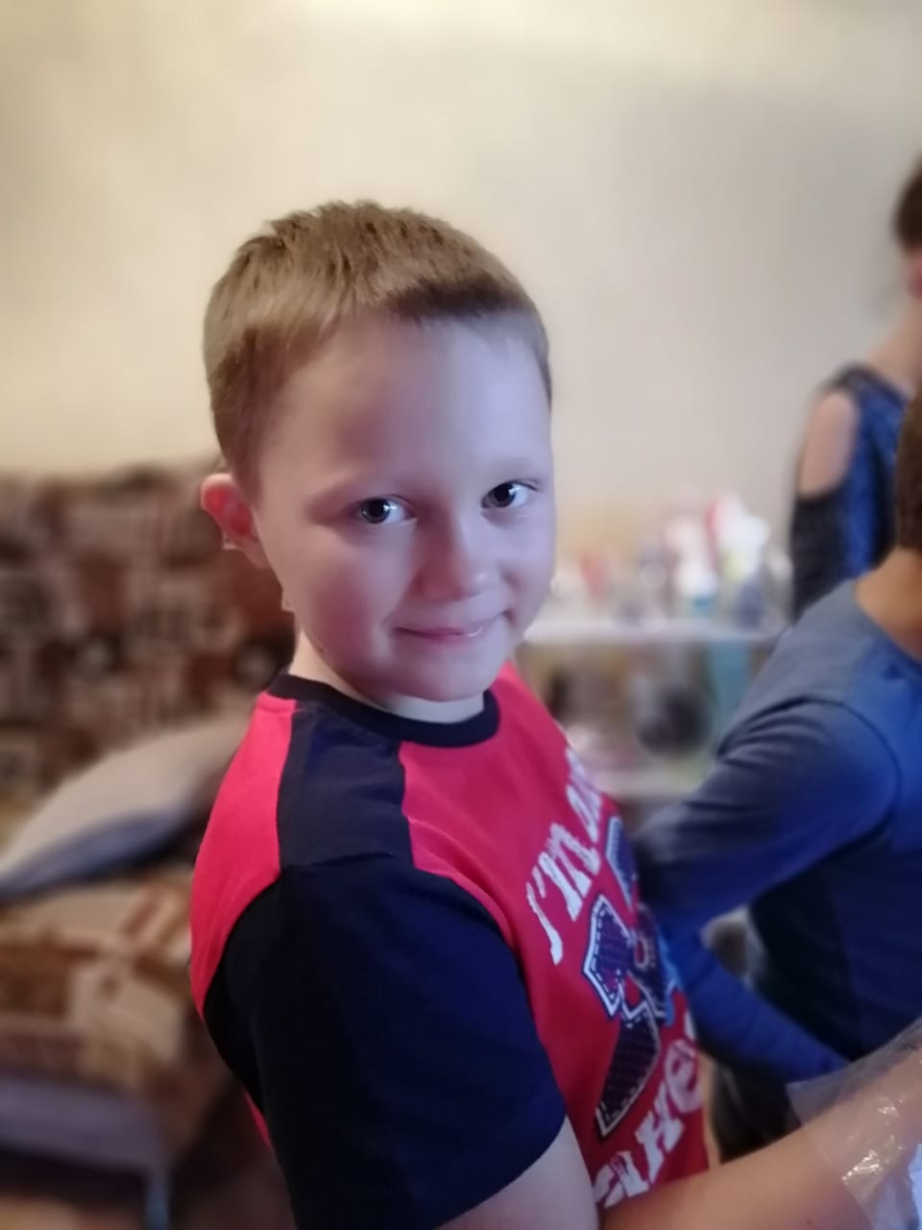
My name is Vitalya Nemaltsev. I am 11 years old.I live in Chulman.It is a small town in Yakutia. It is very far from Moscow.I go to school and study in grade 5.I am good at English, Information Technology, P.E.,Mathematics and Geography. I’ve got a lot of friends. My hobby is playing computer games and I am good at sports. My sister thinks I am smart for my age.
Notes:
11/2/2020
2
2

Slide 3
These are my parents. My mother's name is Alevtina. She is a very kind person. She is the heart and soul of our family .But sometimes my mum is strict. My father's name is Alexander. He is a driver, he works as a taxist. My father is my best friend, and he is the heard of our family. My father is very clever and sporty/
Notes:
11/2/2020
3
3

Slide 4
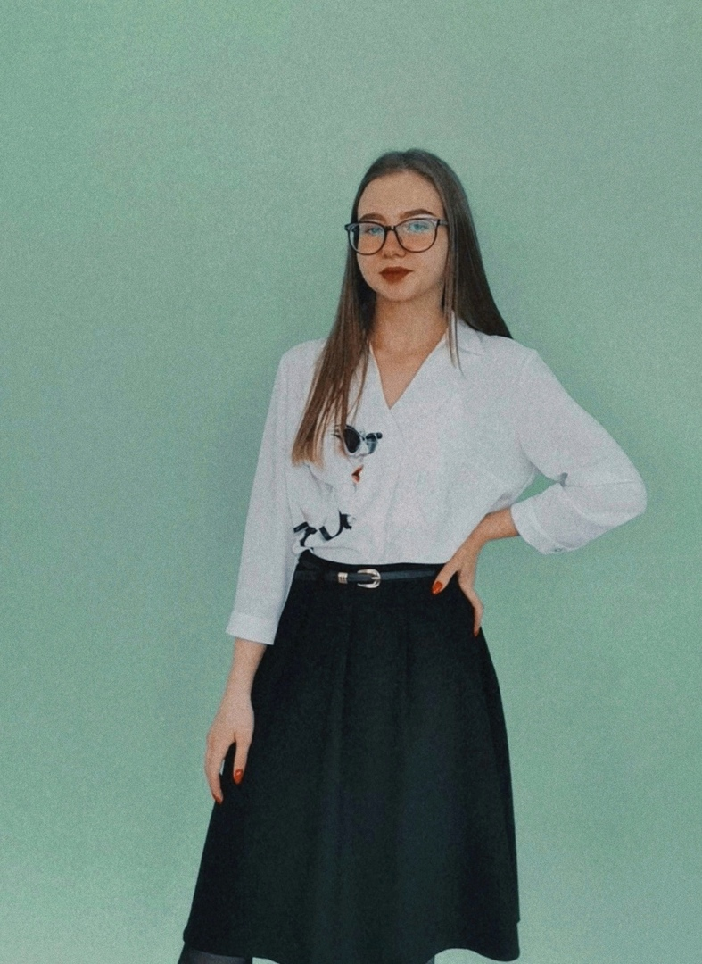
This is my sister. Her name is Snezhana. She is 15 years old.She is much older than I. She is good at all school subjects. My sister is very talented and beautiful. She is good at playing the piano. She goes to school in grade 9.I love her with all my heart.
Notes:
11/2/2020
4
4

Slide 5
These are my grandparents.My grandfather's name is Sergei, and my grandmother's name is Zoya.They live in the city of Belogorsk, and I love to visit them in the summer! I like to get their presents and they love me .
Notes:
11/2/2020
5
5

